Slide 1
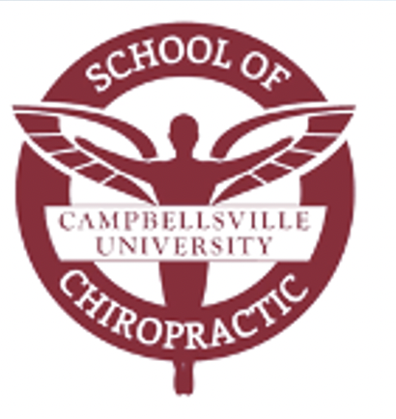
Disorders of CNS
Dr. Gary Mumaugh

Slide 2
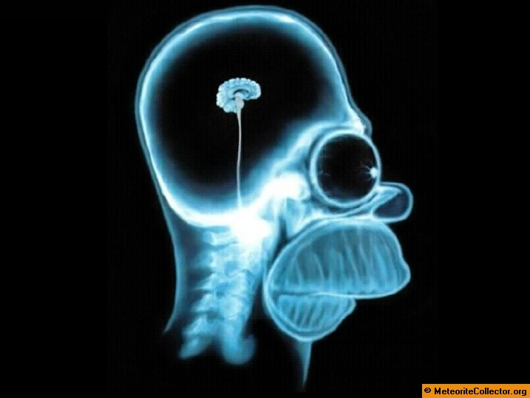
Dr. M’s Recent Brain Scan

Slide 3
CNS Protection
Protection of the Brain
Scalp
5 layers
Skull
Encloses and protects the brain and special senses
Meningeal Protection
Cerebrospinal fluid provides cushion for brain and is a shock absorber

Slide 4
Scalp

Slide 5
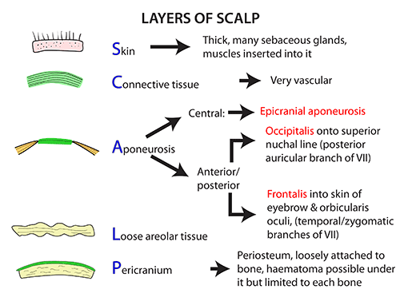

Slide 7
Meningeal Protection

Slide 8
CNS Protection
Protection of the Spinal Cord
Vertebral Column
Protects spinal cord
Articulates with the head, rib, pectoral and pelvic girdles
Hemopoietic and immune system roles
Points of attachment for muscles
Avenue for vertebral arteries

Slide 9
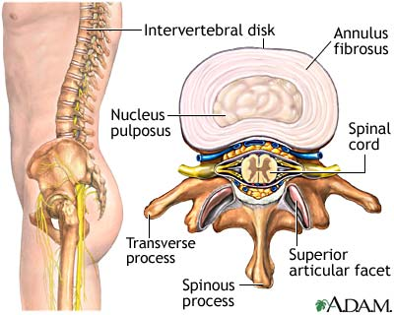

Slide 10
Vertebral Column Figure 20.3 Pg. 534

Slide 11
Edema in the CNS
Edema
An increase in tissue mass due to excess fluid
Vasogenic Edema
Largely confined to white matter of brain & spinal cord
The blood brain barrier is compromised
Due to infection, toxic agent, abnormally permeable capillaries

Slide 12
Edema in the CNS
Cytotoxic Edema
The blood–brain barrier remains intact
A disruption in cellular metabolism impairs functioning of the sodium and potassium pump in the glial cell membrane, leading to cellular retention of sodium and water
Typically due to hypoxia or ischemia due to cardiac arrest
Swelling largely cellular

Slide 15
Circulation of CSF
The CSF starts in the bloodstream and returns to the bloodstream
Starts in the ventricles of the brain
10% goes into the central canal of the spinal cord and travels down the spine before ending in the subarachnoid space at the bottom of the spine.
90% goes through the Foramen of Magendje (Median Aperature) and flows directly into the subarachnoid space
Reabsorption of CSF
Reabsorbed through the arachnoid villa
Reabsorb about 20 ml/hour = rate of production

Slide 16
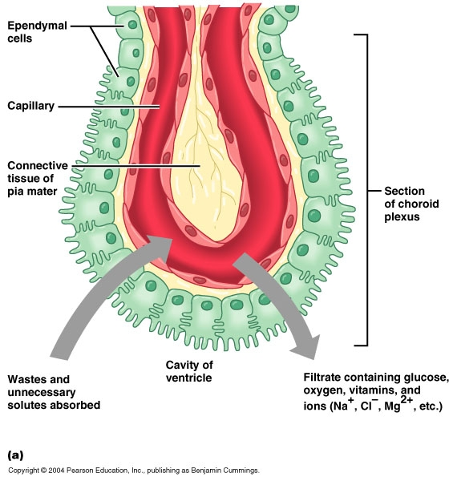

Slide 17
Hydrocephalus
Excess fluid within the cranial vault, subarachnoid space, or both
3 mechanisms for hydrocephalus
Oversecretion of CSF: rare
Impaired absorption of CSF: many ways, anything that raises venous pressure
Obstruction of CSF pathways: due to tumor of fibrosis

Slide 19
Hydrocephalus
Hydrocephalus can occur due to birth defects or be acquired later in life.
Other causes include meningitis, brain tumors, traumatic brain injury, intraventricular hemorrhage, and subarachnoid hemorrhage.

Slide 25
Increased Intracranial Pressure (ICP)
Normal ICP = 5-15 mmHg

Slide 27
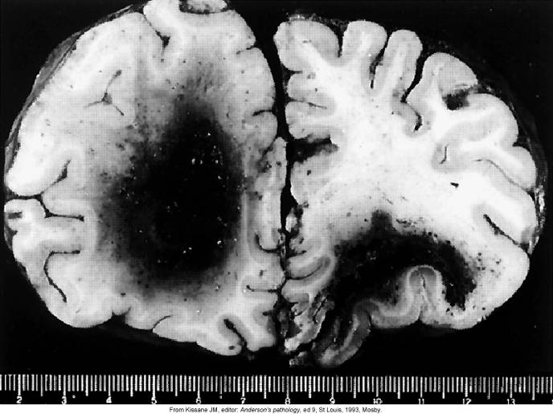
Hematomas

Slide 28
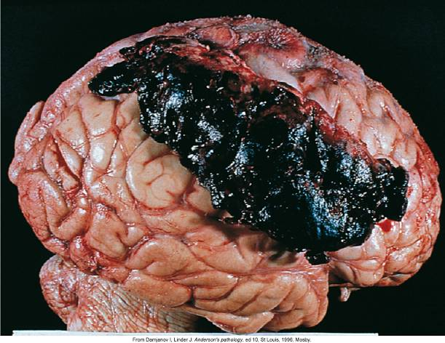
Subdural (Epidural) Hematomas

Slide 29
ICP
What can exacerbate ICP?
CNS edema & tumor masses
Blocked venous return
Heart failure
Hemorrhage into tissue
Subdural/extradural hematoma
Increased CSF and hydrocephalus

Slide 30
ICP
What can decrease ICP?
Expansion of spinal dural sac
Decreased CSF & blood volume
Bone erosion
Atrophy of neural tissue

Slide 31
ICP
How can high ICP be treated?
Depends on if treatable or reversible
Pressure transducer by hole in skull measures ICP
Drugs (barbituates)- slow brain metabolism
Diuretics- lowers blood volume
Emergency craniotomy

Slide 32
Herniation Syndromes
A brain herniation is when brain tissue, cerebrospinal fluid, and blood vessels are moved or pressed away from their usual position inside the skull.
Brain herniation occurs when something inside the skull produces pressure that moves brain tissues. This is most often the result of brain swelling from a head injury, stroke, or brain tumor.

Slide 33
Herniation Syndromes
Brain herniation can occur:
Between areas inside the skull, such as those separated by a rigid membrane like the tentorium or falx
Through a natural opening at the base of the skull called the foramen magnum
Through openings created during brain surgery

Slide 34
Herniation Syndromes

Slide 35
Coma
Coma - lowest level of consciousness
Glasgow Coma Scale: determine level of consciousness
3 = deep coma 15 = normal consciousness
Babinski sign: sharp object pressed firmly to lateral surface of sole of foot – reaction gives depth of coma

Slide 36
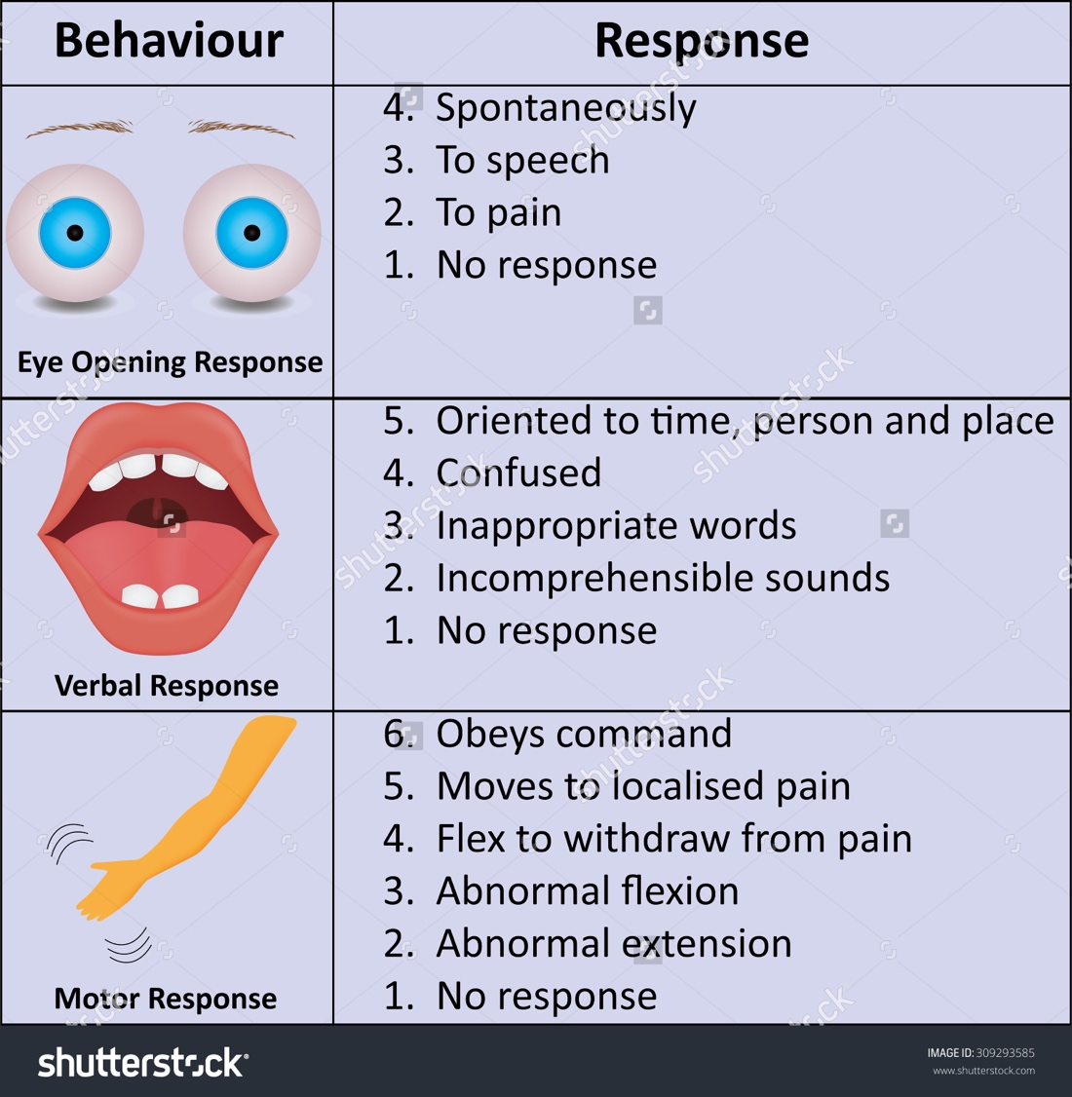
The Glasgow Coma Scale Table 20.2 Pg. 563 Herniation Syndromes 3= Deep Coma 15= Normal Consciousness
Eyes Open
Never | 1
To pain | 2
To verbal stimuli | 3
Spontaneously | 4
Best Verbal Response
No response | 1
Incomprehensible sounds | 2
Inappropriate words | 3
Disoriented and converses | 4
Oriented and converses | 5
Best Motor Response
No response | 1
Extension (rigidity) | 2
Flexion abnormal (rigid) | 3
Flexion withdrawal | 4
Localizes pain | 5
Obeys | 6
Total | 3-15

Slide 37
Cerebrovascular Disorders
Cerebral Aneurysm- distention of cerebral arterial wall
Berry aneurysm: appear at points of bifurcation
Fusiform aneurysm: elongated dilations developing along artery

Slide 38
Signs & symptoms
Cranial nerve dysfunction
Headaches
Lethargy
Neck pain
Bruit: noise detectable over aneurysm due to turbulance

Slide 39
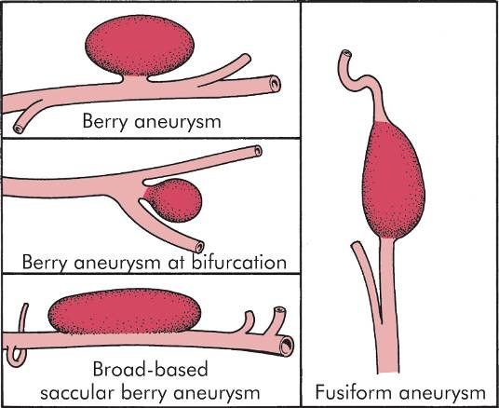
Intracranial Aneurysm

Slide 42
Cerebrovascular Disorders
Subarachnoid Vasospasm
Transitory restriction or narrowing of artery or branch
Often experienced with subarachnoid hemorrhage
Signs & symptoms - vary due to territory and duration

Slide 43
Cerebrovascular Disorders
Arteriovenous Malformations (AVM)
A tangled mass of dilated blood vessels that pass from large or medium sized arteries directly into a vein or venous sinus, bypassing normal capillary beds
Signs & symptoms - ischemia, seizures, headaches, bruit, xanthochromia (yellow color of CSF)

Slide 45
Intracranial Thrombophlebitis
Inflammation & clot formation in the dural venous sinuses and perhaps cerebral veins
Often caused by infections of middle ear, mastoid air cells, paranasal sinuses, scalp, skin around upper lip, nose & eyes
Signs & symptoms - dependent on site and history of site infection
General headache
Papilledema (swelling of retina at optic nerve)
Eye movement abnormalities and pain
Edema of eyelids

Slide 46
Strokes
Sudden onset is due directly & indirectly to deficiency in blood supply
3rd most common cause of death in the USA
Over 600,000 strokes per year
160,000 deaths per year
30% die in acute stage
30% - 40% severely disabled
Ischemic stroke – 80%
Hemorrhagic stroke – 20%

Slide 47
Who is at risk?
Increases with age
Men more than women
Oral contraceptive use
Cigarette smoking
Obesity
Genetic predisposition
Hypertension
Diabetes mellitus
Heart disease

Slide 48
S & S of Strokes
The actual precise symptoms depend on where the CVA was and how large it is
Sudden weakness, numbness or paralysis of one side of the body
Loss of consciousness
Seizure may sometimes occur
Sudden change in mental status, confusion
Slurred speech, dysarthria, aphasia
Prognosis is more guarded if:
loss of consciousness
if a large part of the left side of the brain is affected
This is the dominant side for 95% of people

Slide 49
What to do if you suspect a stroke
Ask the person to say a complete sentence
Ask the person to raise both hands above their heads
Ask the person to walk across the room
Walk behind them to catch of unsteady
If any of the above are present – CALL 911

Slide 50
Preventing Stroke
Controlling hypertension
Manage and control diabetes
Lower blood pressure
Proper diet and exercise
Stop smoking
Anticholesterol drugs if lipids levels high
83mg ASA per day
Any history of TIA
Mini-stroke lasting 1-3 minutes with involvement of face and speech
Referral to vascular surgeon for carotid arteriography
Mini Strokes (TIAs): Don't Ignore Symptoms, Act FAST

Slide 51
Diagnosis of Strokes
History is most important
CT scans present with 95% accuracy
Lumbar puncture if CT normal
CT with LP is 100% accurate diagnostically
MRI are used only if the diagnosis is still uncertain
Open MRI is preferred
Many patients have died in and older style MRI scanner which is enclosed and takes a long time for the test

Slide 52
Transient Ischemic Attack (TIA)
Short episodes of sudden neurological dysfunction that clear up completely
Causes: hypotension, vasospasms, anemia, polycythemia
Symptoms: depends on arteries involved- aphasia, drop attacks, vertigo, nausea, dysarthria, amaurosis fugax (fleeting blindness)
Therapy: anticoagulant drug (ex. Aspirin)

Slide 53
Thrombotic Stroke (most common)
Ischemic Stroke
Permanent damage to part of brain due to ischemia
Thrombosis usually due to atherosclerosis
“stroke-in-evolution” – may progress over weeks
Symptoms: depends on affected area

Slide 54
Ischemic Strokes
80% of strokes
Occlusion of an artery supplying blood to the brain
Ischemic CVA will be localized to the area of occlusion
Two types of ischemic stroke:
Thrombus
Athersclerosis with occlusion of the carotid artery, vertebral artery or within the brain
Embolism from outside the brain

Slide 55
Embolic Stroke - Ischemic Stroke
Embolic Stroke
Embolus lodges in brain artery and creates ischemia that leads to an infarct
Often associated with atrial fibrillation
Symptoms: ischemia, broad function loss, edema, infarction
Rapid development of symptoms with no immediate warning signs

Slide 56
Possible Sources of Emboli
Blood clot from heart
Platelets & fibrous debri from carotid artery
Clumps of myoglobin can break from over exerted muscle in extreme sports
Fat can break off from a large bone fracture
Nitrogen bubbles may build up in bloodstream from scuba divers who decompress to fast
Amniotic fluid can get into the blood during childbirth

Slide 58
Hemorrhagic CVA
Infarction by interrupting blood flow to region downstream from hemorrhage
Damage from expanding hematoma (increased ICP)
Symptoms: fairly rapid onset, increased blood pressure

Slide 59
Hemorrhagic Stroke
20% of strokes
Caused by a rupture in a cerebral artery
Ruptured artery causes inflammation of brain tissue = increased intracranial pressure = damage to both cerebral hemispheres
Because of wide spread damage often fatal
This type of CVA occurs suddenly
Results from arteriosclerosis or severe hypertension

Slide 60
Varieties of Hemorrhagic Stroke
Intracerebral bleeding
Seen in elderly with high blood pressure and fragile vessels, or in patients with bleeding disorders and those on anticoagulants
Subarachnoid bleeding
Seen in 30-40 year olds and are mostly due to congenital ateriovenous malformations
Subdural bleeding
Often occurs in elderly who fall and strike their head
Epidural bleeding
Usually from a ruptured temporal artery and is usually caused by major head trauma

Slide 61
Treatment of Strokes
Ischemic strokes
Thrombolytic therapy - rtPA – recombinant tissue plasma activator has revolutionized CVA tx
Must be administered within 3 hours
Cerebral edema often follows post-stroke
Treated with IV steroids
Heparin used after the initial three hours

Slide 62
Treatment of Strokes
Hemorrhagic strokes
IV sodium nitroprusside to control blood pressure
IV Vitamin K and fresh plasma if patient on Coumadin
If ruptured aneurysm, then high risk brain stent is used (50/50 chance of surgical)

Slide 63
CNS Infection
What are 5 locations of CNS infection?
Meningitis: subarachnoid space
Meningoencephalitis: meninges & adjacent brain tissue
Encephalitis: brain tissue
Myelitis: spinal cord
Abscesses: focal

Slide 64
CNS Infection
Acute Bacterial Meningitis
50-60% fatal if untreated
Infection in subarachnoid space
Treatment: rapid antibiotics
Persistent meningitis can lead to cranial nerve damage, abscess, tissue infarct, and extension into subdural space

Slide 65
CNS Infection
Chronic Bacterial Meningoencephalitis
Syphilis- plug and inflame tiny vessels of the meninges
Lyme Disease- variety of symptoms
Tuberculosis- produces fibrinous exudate in the subarachnoid space

Slide 66
CNS Infection
Meningeal signs
Light sensitivity
Acute: fever, vomiting, drowsiness, stiff neck, muscle aches, back aches
Rapid development
Brudzinki’s sign: abrupt flexion of neck leads to involuntary flextion of knees (if supine)
Kernig’s sign: attempt to extend knee while thigh flexed results in resistance and pain in hamstring

Slide 67
Reye’s Syndrome
Potentially fatal post - viral condition
Symptoms
Renewed vomiting & lethargy
[3/4] clouded consciousness, hyperexcitability→ recovery
[1/4] progressive brain edema→ deepening coma→ death
Pathophysiology not understood
Aspirin is suspected to play a part

Slide 68
CNS Infection
Brain Abscesses
An area of necrosis and pyogenic (pus forming) bacterial infection
Infection introduced at same time as an area of infarct – 2 possible ways:
Septic embolism
Chronic infection

Slide 70
CNS Tumors
2% of all cancer cases in adults
70% above tentorium (w/in cerebral hemisphere, thalamus, etc.)
20% of all cancer cases in children
70% subtentorium (brain stem, cerebellum, 4th ventricle)

Slide 73
CNS Tumors
Mitotically active cells are capable of tumorigenesis
Astrocytes: contribute to blood-brain barrier, structural support
Oligodendrocytes: provide myelin sheaths
Ependymal cells: line ventricles & central canal of spinal cord
Schwann cells: provide myelination in PNS
Treatment- excision or radiation
Benign can be just as bad as malignant if inoperable

Slide 74
CNS Tumors
Primary brain tumors
Gliomas- 70%; most rise from astrocytomas
Meningioma- benign slow-growing tumor, arise from arachnoid membrane
Acoustic neuroma- most peripheral nerve tumors in cranial vault
Oligodendrogliomas- develop in cortex and subcortically

Slide 75
CNS Tumors
Secondary brain tumors
Typically metastasize through blood to brain
Sources- lung, breast, skin, kidney & intestine

Slide 77
CNS Tumors
Pituitary gland
Pituitary adenoma – 2 types
“Secreting type” (less common)- secretes excess hormones
“Null cell”- goes undetected until there is damage
Symptoms: “tunnel vision,” cranial nerve compression, hypopituitarism (if blood supply compressed)
Treatment - surgery or radiation

Slide 80
CNS Tumors

Slide 81
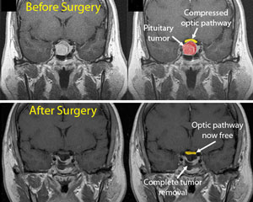
CNS Tumors
Brain Tumors

