Slide 1
Temporal Lobe Anatomy and Function
Dr. Gary Mumaugh
Campbellsville University

Slide 2
Cerebral Cortex – Temporal Lobe Anatomy & Function

Slide 3
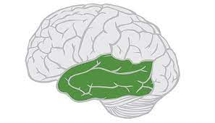
Boundaries of Temporal Lobe
Lateral sulcus (Sylvian fissure)
Separates temporal lobe from frontal and parietal lobes
Preoccipital notch: an imaginary line that can be drawn between the notch and the Lateral sulcus
Separates the temporal lobe from the occipital lobe

Slide 4
Divisions and Functions of Temporal Lobe
Primary Auditory Cortex
Conscious awareness of sound
Auditory Association Cortex
Gives meaning or understanding of sound
Wernicke’s Area
Comprehensive understanding of written or spoken language
Primary Olfactory Cortex and Association Olfactory Cortex
Conscious awareness of smell
Insular Cortex
Conscious awareness of gustation
Visceral sensations & vestibular sensations

Slide 5
Parts of Parietal Lobe

Slide 6
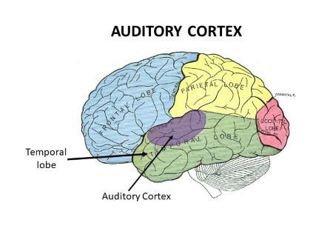
Primary Auditory Cortex
The Primary Auditory cortex is Involved in conscious awareness of sound stimuli
It identifies the 3 characteristics of sound:
Frequency
Pitch
Location

Slide 7
How sound is perceived
Auditory pathway: → Inner hair cells in cochlea→ carried by vestibulocochlear nerve (CN VIII)→ cochlear nuclei in pontomedullary junction→ decussation at level of trapezoid body→ ascends as lateral lemniscus→ goes to thalamus (medial geniculate body)→ primary auditory cortex
There is communication between the 2 sides
The neurons decussate at the level of the trapezoid body, so the information is received controlaterally (opposite side)
Example: a sound stimulus received by the left ear will be heard in the right Primary Auditory cortex

Slide 8
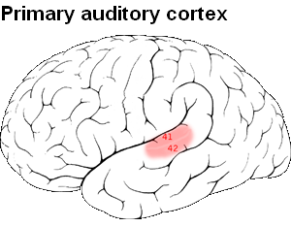
Lesion of Primary Auditory Cortex
It will cause contralateral loss of sound stimuli
Includes difficulty determining the location, pitch and frequency of a sound.

Slide 9
Auditory Association Cortex
Once the stimulus has arrived in the Primary Auditory Cortex, it’s sent to Auditory Association cortex
Analyzes pitch, localization and amplitude of sound
Compares sound characteristics with previous sounds and helps to recognize the meaning and significance of the sound stimulus
Example: a wife tells her husband “she's fine” in a loud manner.
The auditory association cortex will compare that sound characteristics with previous memories and help one recognize she isn't “fine”, instead “she ticked off”.

Slide 13
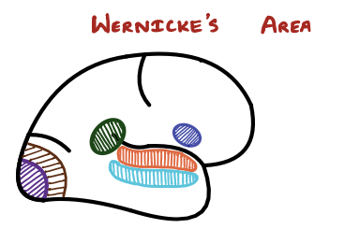
Wernicke’s Area Green in drawing
Responsible for comprehension and understanding of written and spoken language
Receives visual cues from visual association cortex in occipital lobe and auditory information from auditory association cortex in temporal lobe
These information are used to help comprehend the language (written or spoken) being presented.
Then Wernicke’s area sends impulses to Broca's area which is involved in stimulating muscles of speech production

Slide 14
Example: Wife is talking about various things that happened at work today and you decide to tune her out, because you are listening to a Dr. M podcast.
All of a sudden, she says frustratingly with her very upset facial expressions “what did I just say, were you even listening?”
Your Wernicke’s area will allow you to analyze the angry voice and frustrated face of the wife and then comprehend she is “ticked off”.
Wernicke's area then sends that information to Broca’s area and then you respond “yeah of course I was listening”.

Slide 15
Wernicke’s Aphasia (Receptive aphasia)
Caused by damage to Wernicke’s area, usually because of middle cerebral artery stroke.
Symptoms:
Fluent speech: the patient is able to form words and sentences since Broca’s area isn’t damaged, however the speech will make no sense
Inability to comprehend the meaning of a word or sentence

Slide 16
Wernicke’s Aphasia

Slide 17
Primary Olfactory Cortex and Olfactory Association Area
Located deep to temporal lobe, at the level of uncus, on medial portion of the brain
Involved in the awareness of smell and analysis, recognize and identify smell patterns and store these smells in memory pathways

Slide 18
Olfactory pathway:
The smell will activate the receptors located in the nasal activity → activates olfactory nerves (CN I), which cross cribriform plate to reach olfactory bulb → gives rise to olfactory tract→
Medial olfactory stria: directed towards primary orbitofrontal cortex in frontal lobe
Lateral olfactory stria: directed to primary olfactory cortex
From there, the stimulus is sent to Olfactory Association cortex, where it will be stored in our memory
The stimulus can also reach the amygdala (limbic system), where that particular smell will be tied to certain emotions

Slide 19
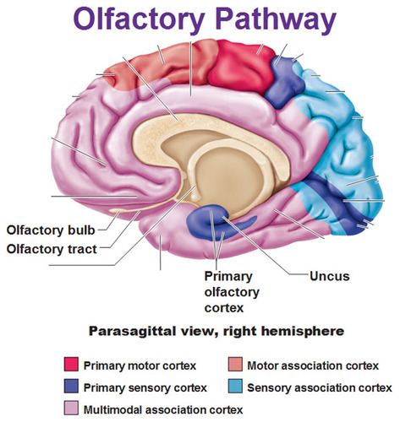

Slide 20
Insular Cortex
Not actually part of the temporal lobe, makes up its own lobe
Located deep in Lateral fissure
Functions:
Receives visceral sensation: pain and temperature information from lungs, heart and GI tract
Information is sent to insula → analyzes, recognizes, and stores memory of visceral sensations
Example:
Gastroenteritis→ activates visceral sensory neurons of GIT→ sends signals to insula→ Insula remembers visceral pain from gastroenteritis

Slide 21
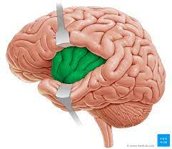
Receives vestibular sensations from inner ear→ Insula
This helps us to be more aware of our dynamic and static equilibrium
Receives gustation (taste) from taste buds in fungiform papillae and vallate papillae→ Cranial nerves (VII and IX)→ nucleus of tractus solitarius→ insula
Insula helps us differentiate between different tastes
Sweet
Sour
Salty
Bitter
Umami

