Slide 1
Endocrine Pathophysiology
Dr. Gary Mumaugh

Slide 2
Essentials of Endocrinology
Main function: releases hormones to control cellular activities of target cells
Autocrine cells: secrete substances that control their own function
Paracrine cells: secrete hormones that diffuse to adjacent cells and regulate their action

Slide 3
Essentials of Endocrinology
Neuroendocrine: nervous system exerts regulatory and control functions on endocrine glands
Tropic hormones: secretions that influence the secretions of another endocrine gland (ex. releasing hormones from hypothalamus to anterior pituitary)

Slide 5
Endocrine Specificity
Most hormones are delivered to their target tissues via the bloodstream, where they bind to a receptor.
Intracellular receptors: steroid and thyroid hormones pass through cell membrane and bind to receptors in the cytoplasm
Cause increase in the production of enzymes that enhance a metabolic pathway’s activity, altering the target tissue’s function

Slide 6
Endocrine Specificity
Membrane receptors: binding site for protein, peptide, and amino acid hormones, which cannot enter the cell
Hormones active receptor systems - G proteins or protein kinases
Alter cytoplasmic concentrations of molecules or ions on which cell processes depend
Hormone binding to either type of receptors causes alteration of the target cell’s level of activity.

Slide 7
Plasma Hormone Level
Plasma hormone level determined by rate of entering and leaving the blood
Rate of entering blood stream determined primarily by secretion rate.
2 components:
Hormone synthesis from dietary or endogenous precursors
Rate of release from the endocrine cell
Notes:
Hormones cleared from blood at steady rate, while concentrations of hormones entering blood stream is variable and the primary determinant of plasma hormone level

Slide 8
Plasma Hormone Level
Cleared from blood stream either by inactivation or excretion
Inactivation at target tissue into nonfunctional forms or in liver into chemically converted inactive forms
Excretion by kidneys
Increased binding rates at target cell induce an increased response.

Slide 9
Endocrine Dysfunction
2 types of dysfunction:
Hypofunction
Hyperfunction
These two concepts are the basis for much of endocrine pathophysiology and should be the first factors considered in clinical situations.

Slide 10
Elevated or Depressed Hormone Levels
Failure of feedback systems
Dysfunction of an endocrine gland
Secretory cells are unable to produce, obtain, or convert hormone precursors
The endocrine gland synthesizes or releases excessive amounts of hormone
Increased hormone degradation or inactivation

Slide 11
Endocrine Hypofunction
Defined as inadequate target tissue response
Causes: hyposecretion or hormone resistance
Hyposecretion may be due to:
Agenesis: lack of gland development
Genetic defect that prevents hormone synthesis
Dietary deficiency

Slide 12
Endocrine Hypofunction
Atrophy of the endocrine gland.
Replacement of normal endocrine tissue with tumor tissue.
Surgery to remove part of a over-secreting gland.
Damage to a functioning gland that is then unable to maintain secretions.
Often accompanied by high levels of control hormones

Slide 13
Endocrine Hypofunction
Decreased or insufficient function of gland
Hormone resistance: insensitivity of a target tissue to its hormone
May be due to:
Hereditary defect that affects the tissue’s ability to synthesize hormone receptors
Autoimmune mechanism in which an antibody binds to the hormone receptors
If faced with a chronically elevated hormone level, the target tissue might reduce the number of hormone receptors

Slide 14
Endocrine Hyperfunction
Exaggerated target tissue responses
Usual cause: hypersecretion - circulating hormone is present in inappropriately high levels
Causes of hypersecretion:
Exposure to high levels of tropic hormones
Defective feedback control
Tumors in the gland- occurs if neoplastic cells retain the ability to secrete functional hormone
Signs and symptoms of endocrine diseases are often puzzling because of altered functions in many body systems at once.

Slide 15
Alterations of Thyroid Function
Hyperthyroidism
Thyrotoxicosis
Graves disease
Hyperthyroidism resulting from nodular thyroid disease
Manifestations related to hypermetabolic state
Thyrotoxic crisis

Slide 16
Hyperthyroidism
Thyroid gland produces thyroxine hormone
An autoimmune disorder
Significantly accelerates metabolism
Sudden weight loss, a rapid or irregular heartbeat, sweating, nervousness or irritability
Fatigue, muscle weakness, difficulty sleeping
Tremor, sweating
Changes in menstrual patterns
Increased sensitivity to heat
8 times more common in women

Slide 18
Etiology of Grave’s Disease
For autoimmune reasons, a group of B lymphocytes secrete IgG which fits into and stimulates the TSH receptors present on cell membranes which increases the production of thyroid hormone.

Slide 20
The characteristic exopthalmus is caused by inflammation of the tissue lining the orbit and extraocular muscles. This causes edema and swelling and fibrosis.
The increased metabolic rate increases appetite and weight gain. The increased rate increases O2 consumption and patient is short of breath.
Increased sympathetic stimulation is present.

Slide 21
Causes
Graves' disease, an autoimmune disorder, is the most common cause of hyperthyroidism
Antibodies produced by your immune system stimulate your thyroid to produce too much thyroxine
Hyperfunctioning thyroid nodules
Thyroiditis
Diagnosis
Radioactive iodine uptake test
Thyroid scan
Increased T3 & T4
Increased ANA titers

Slide 23
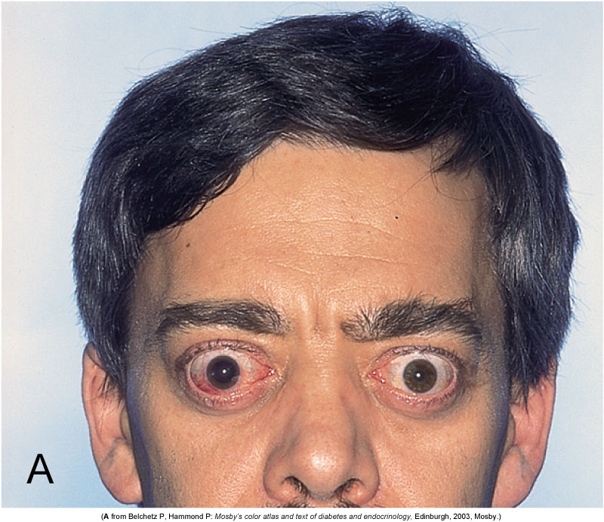
Thyrotoxicosis (Graves Disease)

Slide 24
Hypothyroidism
Low levels of thyroid hormones
Thyroxine (T-4) and Triiodothyronine (T-3)
Causes of hypothyroidism
Autoimmune disease - Hashimoto thyroiditis
Treatment for hyperthyroidism
Radiation therapy
Thyroid surgery
Medications (lithium)
Less common causes
Congenital disease
Pituitary disorder
Iodine deficiency
Pregnancy

Slide 25
Etiology of Hypothroidism
Iodine is essential component to synthesize T3 & T4
As the thyroid hormone levels fall in the blood, the pituitary produces more TSH, which generates enlargement of thyroid goiter
In some areas low in iodine it is called endemic goiter

Slide 26
Pathophysiology of Hypothroidism
Develops slowly with an insidious onset
The lowered metabolic rate causes weight gain, lethargy, tiredness, difficulty concentrating, and cold.
Can affect the adult brain leading to memory loss, slowed mentation, depression and paranoia.
Severe cases is called myxedema madness
Decreased metabolic rate reduces heart rate and stroke volume and over time can cause cardiomegaly.
Decreased metabolic rate causes decreased GI function and decreased sexual function.

Slide 27
Hypothroidism in pregnancy is serious
Thyroid hormones are essential for development and maturation of the infant and child’s brain.
Called cretinism in children
Stunted growth, large head, learning difficulties, dwarfism, pug nose, short neck.

Slide 28
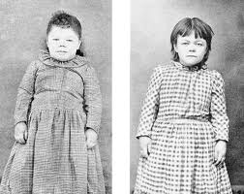
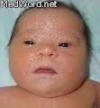
Cretinism: hypothyroid in newborns
Effects if untreated: physical and mental retardation, and stocky, thick body with infantile proportions

Slide 29
Risk factors
Mainly in women over 50
Close relative, with an autoimmune disease
Prior treatment with radioactive iodine or anti-thyroid medications
Received radiation to your neck or upper chest
Have had thyroid surgery (partial thyroidectomy)

Slide 30
S & S
Tiredness, weakness, slow reaction time, hypotension, cold intolerance, weight gain even when dieting
Sluggishness, constipation, muscle weakness
Joint pain, stiffness and swelling
Brittle fingernails and hair
Depression

Slide 31
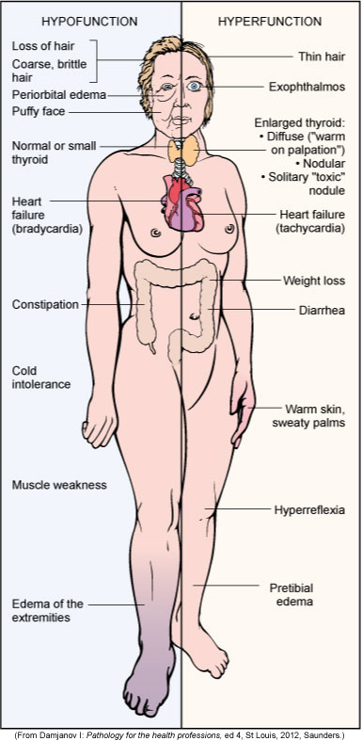
Manifestations of Thyroid Alterations

Slide 32
Goiter: thyroid gland enlargement
Diffuse colloid goiter: generalized enlargement of the thyroid due to increased thyroid stimulating hormone secretions.
Multinodular goiter: nodules form from follicular atrophy and fibrosis
Nontoxic goiter: enlarged gland but hyposecretes hormones
Hashimoto’s Thyroiditis: inflammatory cells overtake functional tissue

Slide 34
Hypothyroidism
Myxdema: chronic hypothyroid in adults causes glycoproteins to be deposited in the dermis
Facial puffiness is characteristic sign
May lead to myxdema coma- can be fatal

Slide 36
Pancreatic Islet Cells
Function: regulate blood glucose levels through the production of insulin and glucagon
Diabetes Mellitus: most common endocrine disorder
Two forms, with differing pathogenesis:
Juvenile onset DM, type I DM, insulin-dependent DM
Maturity onset DM, type II DM, non-insulin-dependent DM

Slide 37
Type 1 Diabetes Mellitus
Genetic susceptibility
Failure of beta cells by autoimmune destruction, requires insulin therapy
Immunologically mediated destruction of beta cells
Manifestations:
Hyperglycemia
Polydipsia
Polyuria
Polyphagia
Weight loss
Fatigue

Slide 38
Type 2 Diabetes Mellitus
Beta cells lose their capacity to produce insulin slowly while target tissue also show reduced sensitivity
Can be controlled with diet and exercise for a while, insulin therapy required less often
Maturity-onset diabetes of youth (MODY)
Gestational diabetes mellitus (GDM)
Common form of diabetes mellitus type 2

Slide 39
Type 2 Diabetes Mellitus
Initial insulin resistance
Later loss of beta cells
Diagnosis (fasting glucose, postprandial glucose)
Manifestations (non-specific): fatigue, pruritus, recurrent infections, visual changes, or symptoms of neuropathy; often overweight, dyslipidemic, hyperinsulinemic, and hypertensive

Slide 40
Insulin physiology
Produced by the beta cells in the islets and lowers blood glucose.
When glucose levels rise, this is detected by the beta cells and secretory granules of insulin emerge from the cell membrane.
The insulin then travels in the hepatic portal vein to the liver and then on to all the body tissues in the systemic circulation.
Insulin is eventually removed from the blood by being broken down by the liver and kidneys.

Slide 41
Insulin lowers blood glucose levels by converting glucose into insoluble glycogen for storage in the liver and muscles.
Insulin is needed to transfer glucose in tissue fluids through a gate into the cytosol of the cell.
Without this insulin action, glucose cannot enter the cell and cannot be used by the mitochondria in energy production.
The irony is that the tissue fluids have to much glucose and the intracellular mitochondria does not have enough.

Slide 42
Insulin and proteins
Insulin stimulates protein metabolism and increases the movement of amino acid into cells.
Insulin also prevents the catabolism of proteins.
Insulin and fats
Insulin promotes the synthesis of fatty acids and glycerol in the blood causing hyperlipidemia.

Slide 43
Insulin receptors
Insulin can only exert a physiological effect when it is combined with a specific receptor. These are transmembrane proteins which means that part of the receptor is inside the cell and part is outside the cell.

Slide 45
Chronic Complications of Diabetes Mellitus
Macrovascular disease
Affects large artery walls with fatty deposits that leads to fibrous collagen and plaque formation.
Coronary artery disease
Stroke
Peripheral arterial disease
Leads to ischemia and possible gangrene.
Diabetic neuropathies
Infection

Slide 46
Chronic Complications of Diabetes Mellitus
Microvascular disease
There is a progressive thickening of the basement membranes which narrow the lumen and lowers elasticity.
This leads to localized ischemia and hypoxia, which causes more vascular compromise.
Retinopathy
Diabetic nephropathy

Slide 47
Hypoglycemia
Low blood sugar
Normal levels = 80-110 mg/dL
Mild = <80 Significant symptoms <60
Causes
Most are diabetics with to much insulin usage
Fasting
Alcoholics and liver disease
Drinking alcohol with sugar causes temporarilly
Overeating
Pancreatic tumor
Addison’s disease

Slide 48
S & S – occurs when blood sugar < 60 mg
Sweatiness, dizziness, nervousness, shaking
Anxiety, faintness, weakness
Palpitations, hunger
Confusion, inappropriate behavior
Diagnosis
Patient’s history
Glucose tolerance test
Fasting glucose and insulin levels
Treatment
Glucose now!!

Slide 50
Adrenal Cortex
Adrenocortical Hypersecretion (Hyperadrenalism)
Cushing’s Syndrome: cortisol hypersecretion
Hyperaldosteronism: hypersecretion by aldosterone-secreting cells.
Adrenal virilism: androgen hypersecretion in females, induces various masculine traits
Sexual precocity: androgen hypersecretion in young males leads to rapid and premature sexual development

Slide 51
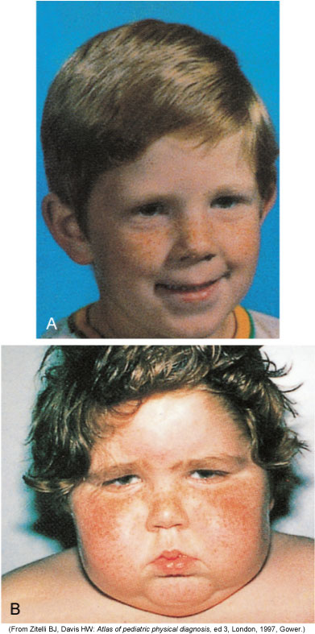
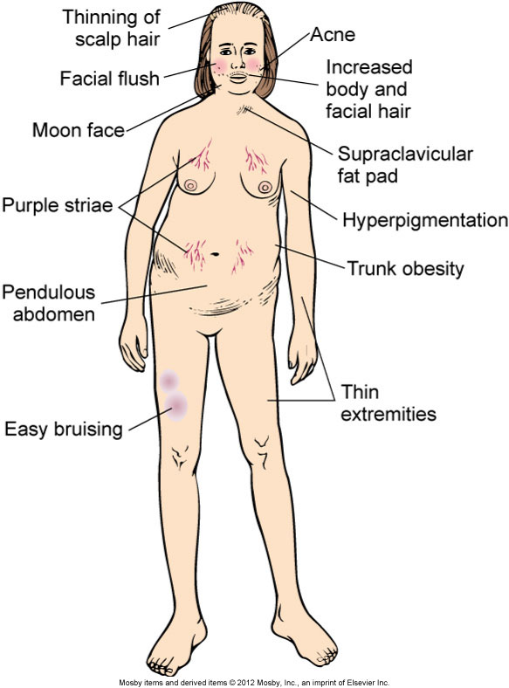
Cushing Disease

Slide 52
Abdominal striae of Cushings

Slide 53
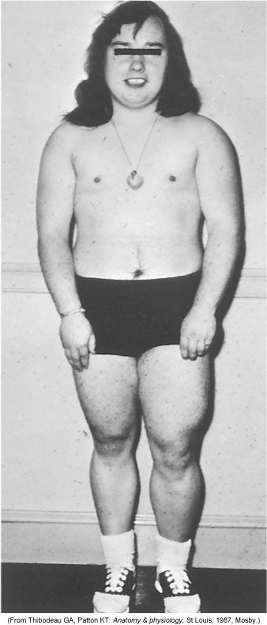
Virilization

Slide 54
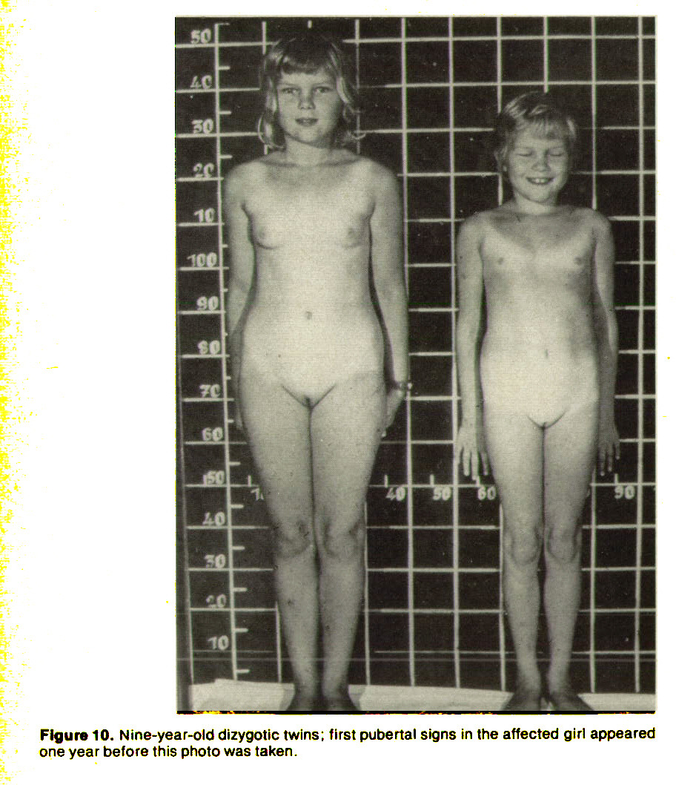
Sexual Precocity
9 year old twins 4 year old

Slide 55
Adrenocortical Hyposecretion (Hypoadrenalism, Addison’s disease)
Corticosteroid deficiency- destruction of cortex or suppression of ACTH by therapeutic doses of glucocorticoids
Characteristic feature: excess pigmentation and high vulnerability to stress

Slide 56
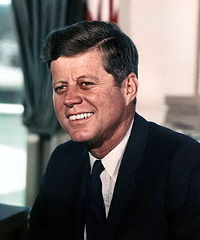

Slide 57
Hyperparathyroidism
Usually caused by a parathyroid adenoma
More common in women
Often causes bone pain from high calcium
Hypercalcemia is also seen in metastatic bone disease (from breast, lung, prostate) and sometimes in pregnancy
S & S
Bones – bone pain from high calcium
Stones – kidney stones common
Groans – pain and slow muscle contractions
Moans – psychiatric and mental changes

Slide 58
Hypoparathyroidism
Often seen after surgery of thyroid and parathyroid
If the parathyroid glands have been removed, then the diagnosis will be permanent
Results in low serum calcium & high serum phosphate
S & S
Low calcium causes muscle cramps, tetany, & paresthesias
Convulsions and arrhythmias
Acute onset, especially after thyroid surgery, could lead to respiratory spasm and suffocation – needing tracheostomy

Slide 59
Hypopituitarism
Pituitary gland fails to produce one or more of its hormones, or doesn't produce enough of them
Causes
Pituitary ademomas
Strokes
Metastatic carcinomas
Primary brain tumors
Autoimmune disorders
Brain trauma
Encephalitis
Idiopathic

Slide 60
Signs & Symptoms
Depending on which hormones are deficient
Fatigue , Headaches , Low tolerance for stress
Muscle weakness , Nausea
Constipation , Weight loss or gain
A decline in appetite , Abdominal discomfort
Sensitivity to cold or difficulty staying warm
Visual disturbances
Loss of underarm and pubic hair
Joint stiffness
Hoarseness
Facial puffiness
Thirst and excess urination
Low blood pressure
Lightheadedness when standing

Slide 61
Men may experience
Loss of interest in sexual activity
Erectile dysfunction
Decrease in facial or body hair
Women mat experience
Irregular or no menstrual periods
Infertility
Inability to produce milk for breast-feeding
Children may experience
Stunted growth
Short stature
Slowed sexual development

Slide 62
Hyperpituitarism
Excessive production of growth hormone, which continues to be produced well into adulthood
In adults, since the growth plates are closed, excessive levels cause abnormal growth of hands, feet, and internal organs – called acromegaly
In children, excess growth hormone causes increased height known as gigantism
Diagnosis
Elevated GH in blood test
Pituitary tumor on CT or MRI

Slide 64
