Slide 1
Pediatric Orthopedic Pathology Dr. Gary Mumaugh

Slide 2
Congenital Defects
Clubfoot (congenital equinovarus)
Forefoot is adducted and supinated
Positional equinovarus
Idiopathic congenital equinovarus
Teratologic equinovarus

Slide 3
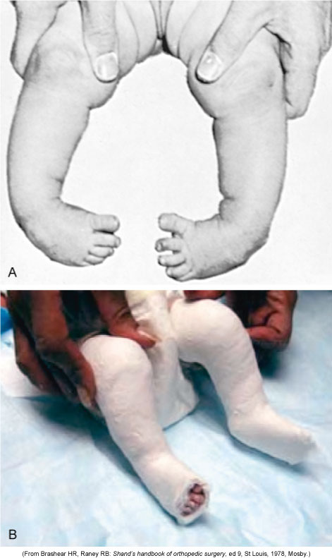
Clubfoot

Slide 4
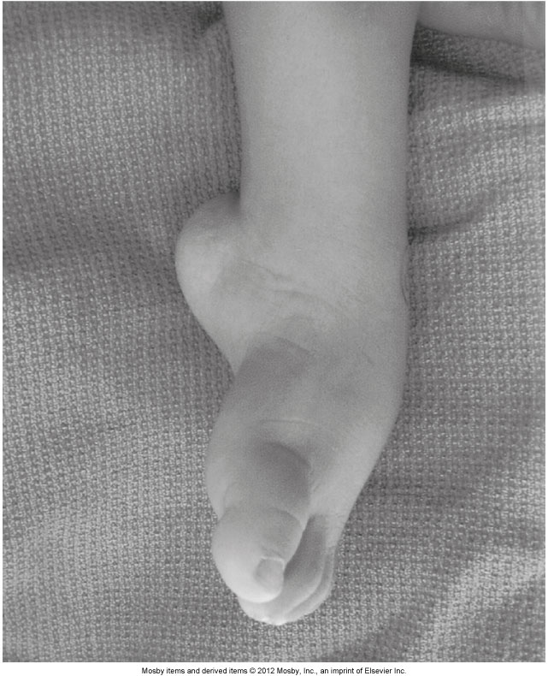
Clubfoot

Slide 5
Congenital Defects
Developmental dysplasia of the hip (DDH)
Abnormality of the hip that can affect the femoral head, acetabulum, or both
Risk factors:
Female sex
Positive family history
Breech presentation

Slide 6
Congenital Defects
Developmental dysplasia of the hip
The hip can present as subluxated, dislocated, or acetabular dysplasia
Manifestations:
Asymmetry of skinfolds at groin crease
Galeazzi sign
Limitation of hip abduction
Positive Ortolani sign
Positive Barlow test

Slide 7
Congenital Defects
Developmental dysplasia of the hip
Clinical management
Outcome becomes poorer with age
Pavlik harness
Closed reduction with spica casting
Surgery

Slide 8
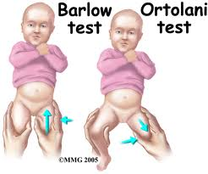

Slide 9
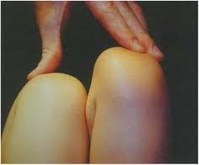

Slide 10
Osteogenesis Imperfecta
“Brittle bone disease”
Defect in type I collagen production
Bone and vessel collagen

Slide 11
Osteogenesis Imperfecta
Clinical manifestations:
Osteopenia
Increased rate of fractures
Bone deformity (bowing)
Short stature
Blue sclera and poor dentition
Aortic aneurysm

Slide 12
Osteogenesis Imperfecta
Clinical management:
Surgical
Intramedullary and telescoping rod placement
Medical
Increased calcium and vitamin D
Biphosphates

Slide 13
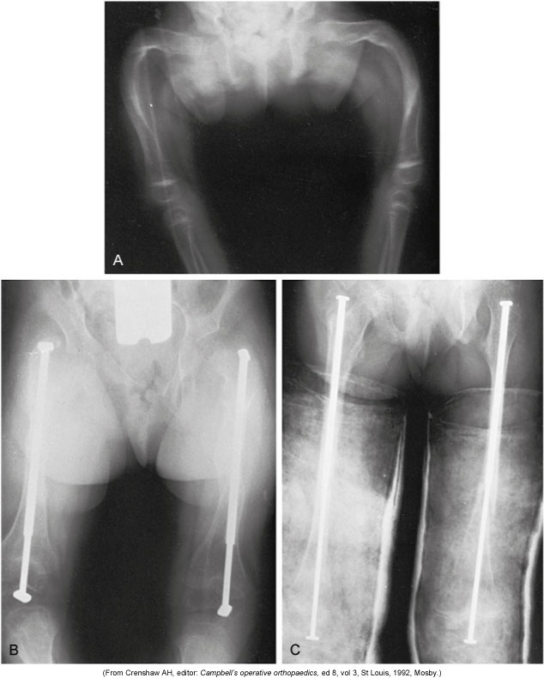
Osteogenesis Imperfecta

Slide 14
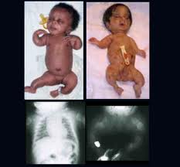

Slide 15
Osteomyelitis
Bone infection from bacteria or tuberculosis (granulomatous)
Acute hematogenous osteomyelitis in children frequently begins as a blood abscess in the metaphysis of the bone
The abscess ruptures under the periosteum and spreads along the bone shaft or into the bone marrow

Slide 16
Osteomyelitis
Clinical manifestations:
Pain, swelling, warmth, fever
Elevated white blood cells, C-reactive protein, and erythrocyte sedimentation rate
Clinical management:
Antibiotics for 6-week regimen
Surgical debridement

Slide 17
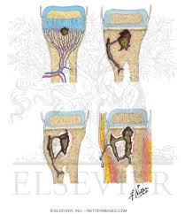

Slide 18
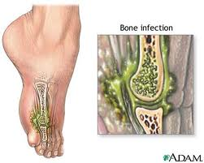

Slide 19
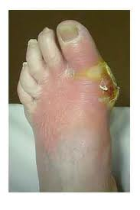

Slide 20
Septic Arthritis
Caused by bacteria or granulomatous
Surgical emergency
Occurs primarily or secondary to osteomyelitis
Lysosomes destroy articular cartilage and interrupt blood supply

Slide 21
Septic Arthritis
Clinical manifestations:
Pseudoparalysis
Inability to bear weight
Guarded motion of the joint
Malaise
Anorexia

Slide 22
Septic Arthritis
Clinical management:
Staphylococcus aureus most common bacteria
Surgical debridement
Antibiotic therapy
Long-term follow-up

Slide 23
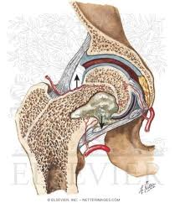
Septic Arthritis

Slide 24
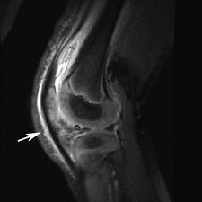
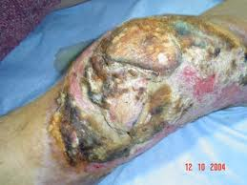

Slide 25
Juvenile Rheumatoid Arthritis (JRA)
Childhood form of rheumatoid arthritis
The basic pathophysiology of JRA is the same as the adult form
Three distinct modes of onset:
Oligoarthritis
Polyarthritis
Stills disease

Slide 26
Juvenile Rheumatoid Arthritis
Differences in JRA and adult RA:
Large joints are affected
Chronic uveitis
Low detection of rheumatoid factor
Subluxation and ankylosis of the cervical spine
Treatment
Supportive with anti-inflammatories and methotrexate

Slide 27
Osteochondrosis
Avascular diseases of the bone
Decrease blood supply
Trauma
Change in clotting sensitivity
Vascular injury
Legg-Calvé-Perthes disease
Interrupted blood supply to the femoral head
Deformation due to ischemia is permanent

Slide 28
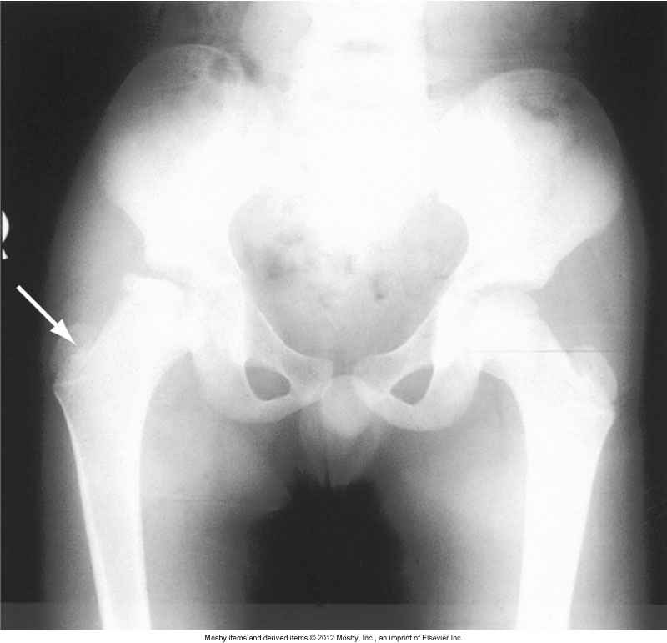
Osteochondrosis

Slide 29
Osteochondrosis
Legg-Calvé-Perthes disease
Clinical manifestations:
Spasm on rotation of hip
Limited internal rotation or abduction of hip
Trendelenburg gait
Clinical management:
Anti-inflammatories
Serial radiographs
Surgery

Slide 30
Legg-Calvé-Perthes Disease

Slide 31
Osteochondrosis
Osgood-Schlatter disease
Tendinitis of the anterior patellar tendon and osteochondrosis of the tubercle of the tibia
One of the most common ailments in children involved in sports
Clinical manifestations:
Pain
Swelling
Clinical management:
Restricted activity
Bracing and knee immobilizer

Slide 32
Scoliosis
Scoliosis is a curvature of the spine that involves both lateral curvature and rotation
Idiopathic (80% of cases)
Congenital
Teratogen
Medical management:
Bracing
Surgery

Slide 33
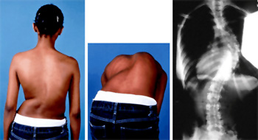
Scoliosis

Slide 34
Muscular Dystrophies
Group of inherited disorders that cause degeneration of skeletal muscle fibers
The muscular dystrophies cause progressive, symmetric weakness and wasting of skeletal muscle groups

Slide 35
Duchenne Muscular Dystrophy
Most common of the muscular dystrophies
X-linked recessive inheritance
Deletion of a segment of DNA or a single gene defect on the short arm of the X-chromosome
Generally affects boys
Duchenne muscular dystrophy gene
Encodes for the dystrophin protein
Dystrophin maintains the structural integrity of the cytoskeleton

Slide 36
Duchenne Muscular Dystrophy
Manifestations of the disorder begin to appear by approximately 3 years of age:
Slow motor development
Progressive weakness
Muscle wasting
Sitting and standing are delayed
The child is clumsy, falls frequently, and has difficulty climbing stairs

Slide 37
Musculoskeletal Tumors
Benign bone tumors
Osteochondroma
Inherited syndrome of hereditary multiple exostoses
Nonossifying fibroma
Sharply demarcated, cortically based lesions of fibrocytes

Slide 38
Musculoskeletal Tumors
Malignant bone tumors
Osteosarcoma
Most common tumor in childhood
Originates in mesenchymal cells
Linked to deletion of genetic material
Bulky tumor extending into soft tissue

Slide 39
Musculoskeletal Tumors
Osteosarcoma
Clinical manifestations:
Night pain, swelling, warmth,
Cough, dyspnea, and chest pain if lung metastasis
Clinical management:
Graded according to malignancy
Surgery and chemotherapy

Slide 40
Musculoskeletal Tumors
Ewing sarcoma
Most lethal bone tumor
Translocation of chromosome 11 and 22
Breaks through bone to form soft tissue mass
Metastasizes to nearly every organ

Slide 41
Musculoskeletal Tumors
Ewing sarcoma (cont’d)
Clinical manifestations:
Pain that increases in severity
Fever
Malaise
Anorexia
Clinical management:
Radiation and chemotherapy
Surgical debridement

Slide 42
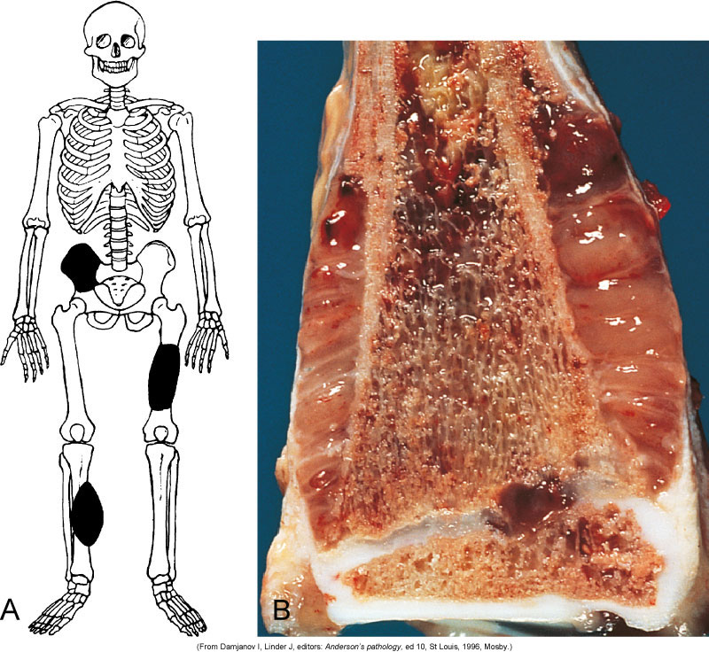
Malignant Bone Tumors

Slide 43
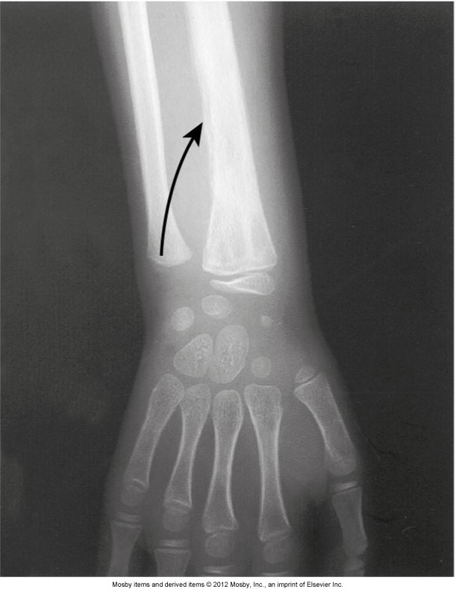
Malignant Bone Tumors

Slide 44
Nonaccidental Trauma
“Corner” metaphyseal fractures
Long bone fractures caused by a twisting force
Transverse tibial fractures are the most common
Associated with child abuse, but osteogenesis imperfecta must be ruled out
Legally mandated to report child abuse

