Slide 1
Trauma Chapter 24
Dr. Gary Mumaugh and Dr. Bruce Simat
University of Northwestern St. Paul

Slide 2
Overview of Traumatic Injury
Factors affecting wound production
Amount of energy
Duration of impact
Surface area
Tissue Characteristics

Slide 3
Wound Classification
Wounds caused by mechanical forces:
Abrasion: epidermis is scraped off,
produced by friction, usually minor.
Contusion: a bruise—blood loss into tissue spaces, surface is unbroken.
Hematoma: Focal pooling of blood within a tissue
Coup injury: blow to brain causes contusion at site of impact.
Countrecoup injury: contusion on opposite side of brain due to brain moving in skull.

Slide 4
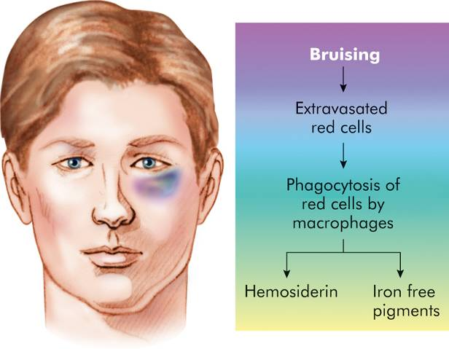
Manifestations of Cellular Injury

Slide 6
Brain Trauma
Major head trauma
A traumatic insult to the brain possibly producing physical, intellectual, emotional, social, and vocational changes
Transportation accidents
Falls
Sports-related event
Violence

Slide 7
Brain Trauma
Closed (blunt, nonmissile) trauma
Head strikes hard surface or a rapidly moving object strikes the head
The dura remains intact and brain tissues are not exposed to the environment
Causes focal (local) or diffuse (general) brain injuries

Slide 9
Brain Trauma
Open (penetrating, missile) trauma
Injury breaks the dura and exposes the cranial contents to the environment
Causes primarily focal (local) injuries

Slide 10
Brain Trauma
Coup injury
Injury directly below the point of impact
Contrecoup
Injury on the pole opposite the site of impact
Compound fractures
Basilar skull fracture

Slide 11
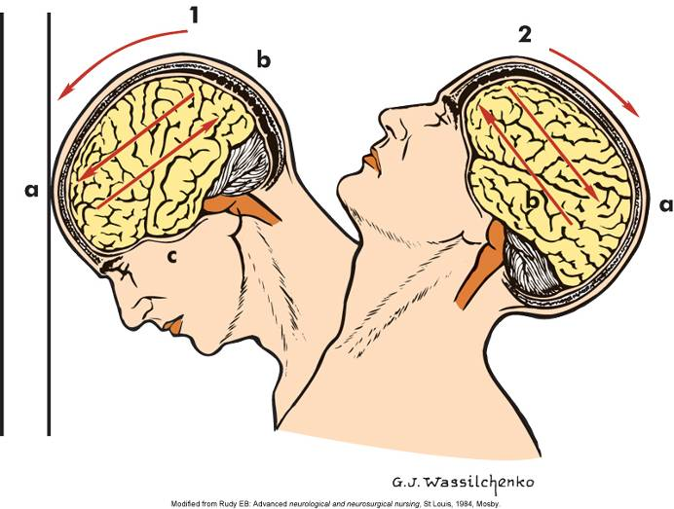
Brain Trauma

Slide 12
Focal Brain Injury
Observable brain lesion
Force of impact typically produces contusions
Contusions can cause:
Extradural (epidural) hemorrhages or hematomas
Subdural hematomas
Intracerebral hematomas

Slide 13
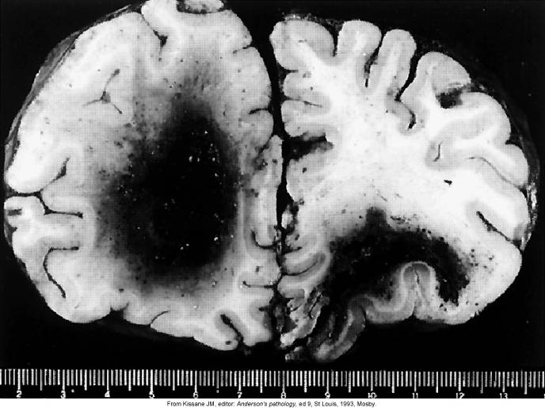
Hematomas

Slide 14
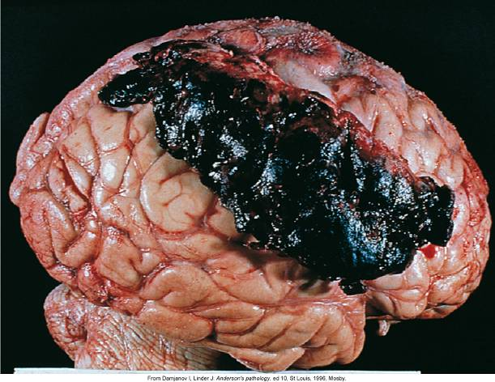
Subdural (Epidural) Hematomas

Slide 15
Wound Classification
Laceration: caused by tearing or
splitting of skin or organ surface.
Different than an incision which is a smooth slice
Configurations: straight, curved, stellate (star-shaped)
Rupture: deep laceration or when hollow organ’s wall tears completely through.

Slide 17
Wound Classification
Penetrating wounds: caused by sharp, long object, causing deep and narrow wound.
Serious blood loss
Vital organs may be reached, causing severe hemorrhage or extensive peritonitis.
Bone fracture:
Many different types, depending on the forces that are applied to the bone.

Slide 20
Types of Bone Fractures
Compound (open) – bone ends penetrate the skin
Simple (closed) – bone ends do not penetrate the skin
Greenstick – incomplete fracture where one side of the bone breaks and the other side bends; common in children
Comminuted – bone fragments into three or more pieces; common in the elderly
Compression – bone is crushed; common in porous bones

Slide 21
Common Types of Fractures
Table 6.2.1

Slide 22
Common Types of Fractures
Table 6.2.2

Slide 23
Common Types of Fractures
Table 6.2.3

Slide 25
Craniocerebral Trauma
Primary brain injury: initial trauma causing injury, like a blow to the skull.
Secondary brain injury: caused by complication of primary injury: infarction, loss of function, epilepsy, etc.
Types of brain injury:
Concussion: period of lost or altered consciousness that follows a brain injury and period of paralysis of nervous function.

Slide 26
Craniocerebral Trauma
Coup and Contrecoup Injuries
Basal Skull Fracture: when hit hard, the area that is directly hit withstands the pressure, but the opposite side fractures.
Closed head injuries: meningeal and vascular protection of brain intact.
Open head injuries: protection is broken in some way.

Slide 27
Craniocerebral Trauma
Hematomas:
Extradural hematoma: artery is blood source.
Subdural hematoma: bridging vein is usually the blood source.
Acute: develops over 24-48 hours.
Subacute: develops in 48 hours to two weeks.
Chronic: slow leak, initial trauma was minor.

Slide 28
Hematomas

Slide 29
Subdural (Epidural) Hematomas

Slide 30
Spinal cord trauma: caused by hyperextension, crushing, dislocation.
Spinal shock: loss of function below site of injury

Slide 31
Spinal Cord Trauma
Most commonly occurs due to vertebral injuries
Simple fracture, compressed fracture, and comminuted fracture and dislocation
Traumatic injury of vertebral and neural tissues as a result of compressing, pulling, or shearing forces

Slide 32
Spinal Cord Trauma
Most common locations: cervical (1, 2, 4-7), and T1-L2 lumbar vertebrae
Locations reflect most mobile portions of vertebral column and the locations where the spinal cord occupies most of the vertebral canal

Slide 33
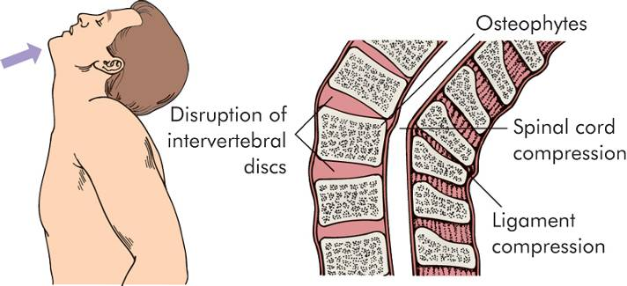
Spinal Cord Trauma

Slide 34
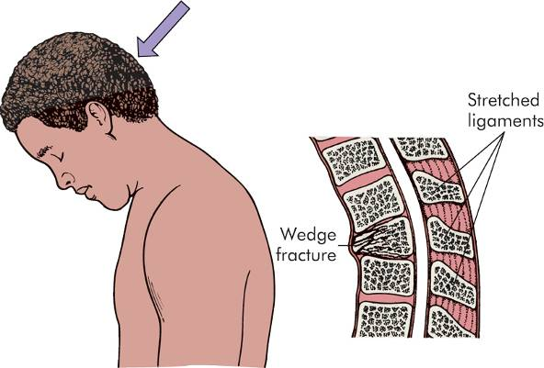
Spinal Cord Trauma

Slide 35
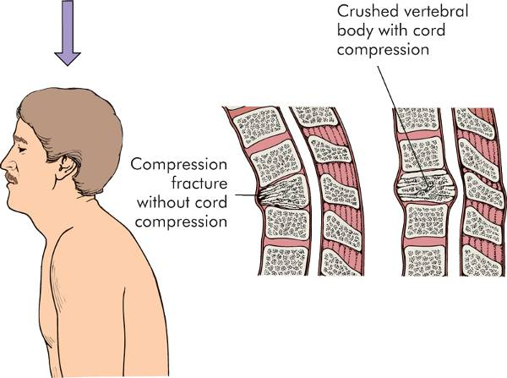
Spinal Cord Trauma

Slide 36
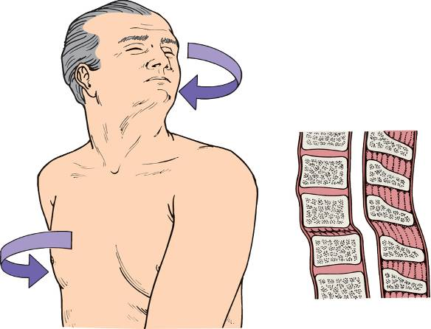
Spinal Cord Trauma

Slide 37
Spinal Cord Trauma
Spinal shock
Normal activity of the spinal cord ceases at and below the level of injury. Sites lack continuous nervous discharges from the brain.
Complete loss of reflex function (skeletal, bladder, bowel, sexual function, thermal control, and autonomic control) below level of lesion

Slide 38
Spinal Cord Trauma
Paraplegia
Quadriplegia
Autonomic hyperreflexia (dysreflexia)

Slide 39
Autonomic dysreflexia means an over-activity of the Autonomic Nervous System.
It can occur when an irritating stimulus is introduced to the body below the level of spinal cord injury, such as an overfull bladder. The stimulus sends nerve impulses to the spinal cord, where they travel upward until they are blocked by the Lesion at the level of injury. Since the impulses cannot reach the brain, a Reflex is activated that increases activity of the sympathetic portion of autonomic nervous system.

Slide 40
Thoracic Trauma
Flail Chest: three or more adjacent ribs are fractured and section can move independently.
Can result in hypoxemia and hypercapnia due to hypoventilation.
Closed pneumothorax: fractured ribs puncture lung and allow air into pleural space, but chest wall is not open to atmospheric air.
Open pneumothorax: atmospheric air enters pleural space directly through opening.

Slide 41
Thoracic Trauma
Tension pneumothorax: chest wound closes during expiration, causing increased pressure in one pleural cavity.
This forces the collapsed lung, heart, and other structures into the other pleural cavity.
Hemothorax: blood in the pleural space.
Ruptures in the diaphragm can cause herniation, usually on the left side.
Cardiac wounds often involve laceration of the aorta or vena cavae.

Slide 42
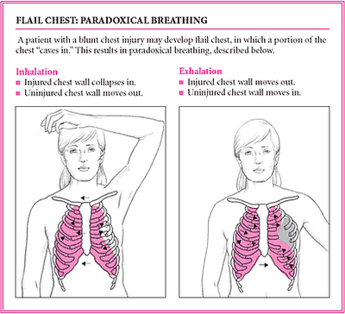

Slide 43
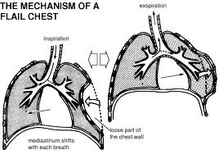
Flail Chest

Slide 44
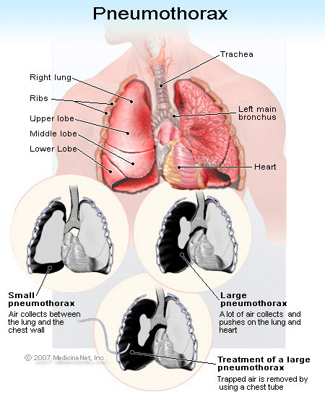

Slide 45
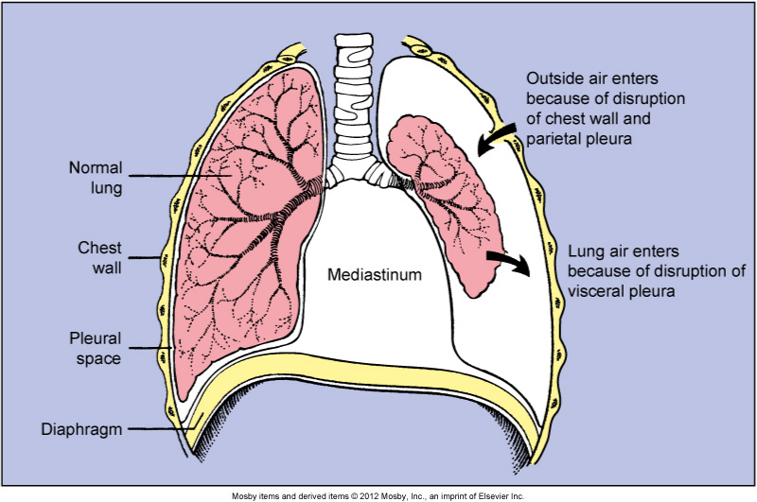
Pneumothorax

Slide 46
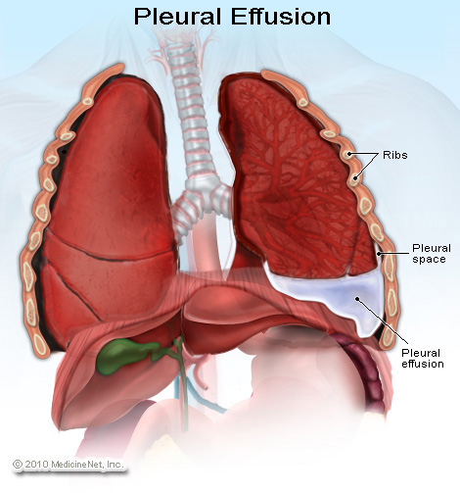

Slide 48
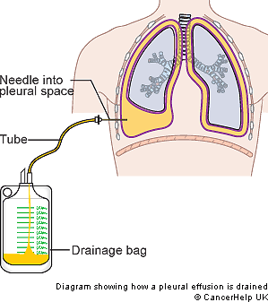

Slide 49
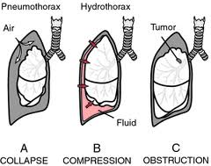

Slide 50
Abdominal Trauma
Nonpenetrating trauma can cause contusion, laceration, or rupture of abdominal viscera.
The spleen is the most often damaged organ in cases of blunt trauma.
Penetrating wounds increase risk of abdominal infection.
Evisceration: large wall defect allows abdominal organs to escape from abdomen.

Slide 51
Trauma in Athletics
Stress fracture: overuse injury, load is not enough to cause acute fracture, but exceed that level that the bone can absorb without damage.
Ligaments: partial or complete tears of ligaments due to excessive stresses.
Avulsion fracture: ligament is intact but pulls off a section of bone at its attachment site.

Slide 52
Trauma in Athletics
Joints: injuries involve forces which separate bones in a joint.
Sprain (bone return to position)
Dislocation (bones remain displaced)
Tendons: long healing time due to poor vascularization.
Muscles:
Distraction ruptures: caused by high contractile loads or excessive stretching.
Compression ruptures: caused by direct impact which forces muscle against bone.

Slide 53
Burn Trauma
Burns caused by thermal energy applied to skin at a rate greater than it can be dissipated.
Factors affecting skin’s ability to absorb and dissipate heat:
Thickness
Blood supply
Water content
Pigmentation
Presence of hair and other surface matter (dirt, cosmetics, etc.)

Slide 54
Burn Trauma
Classification
First-degree burn: damages epidermis only, no significant necrosis. (Sunburn)
Second-degree burn: destruction of epidermis and part of dermis, causes blisters.
Third-degree burn: damage to epidermis, dermis, and underlying tissue, skin grafting usually needed.

Slide 58
Burn Trauma
Alternate classification system:
Partial-thickness burn: epidermis and some of dermis damage (second-degree).
Full-thickness burn: epidermis and whole dermis damage (third-degree).
Consequences of severe burns:
Shock
Infection
Deformity

