Slide 1
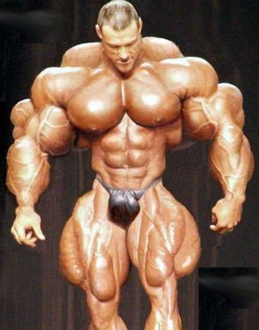
Muscular Tissue
Dr. Gary Mumaugh

Slide 2
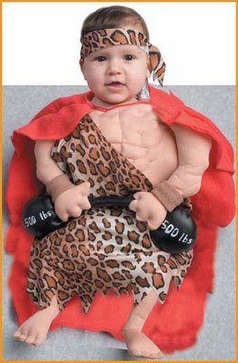
Muscle Overview
The three types of muscle tissue are skeletal, cardiac, and smooth
These types differ in structure, location, function, and means of activation

Slide 3
Functional Characteristics of Muscle Tissue
Excitability, or irritability – the ability to receive and respond to stimuli
Contractility – the ability to shorten forcibly
Extensibility – the ability to be stretched or extended
Elasticity – the ability to recoil and resume the original resting length

Slide 4
Muscle Function
Skeletal muscles are responsible for all movement
Cardiac muscle is responsible for the movement of blood through the body
Smooth muscle helps maintain blood pressure, and squeezes or propels substances (i.e., food, feces) through organs
Muscles also maintain posture, stabilize joints, and generate heat

Slide 5
Three Types of Muscle
Skeletal
Voluntary or somatic
Usually attaches to bones
Striated
Cardiac
Involuntary or autonomic
Walls of Heart
Striated
Smooth
Involuntary or autonomic
Walls of viscera, blood vessels and skin
Not striated

Slide 6
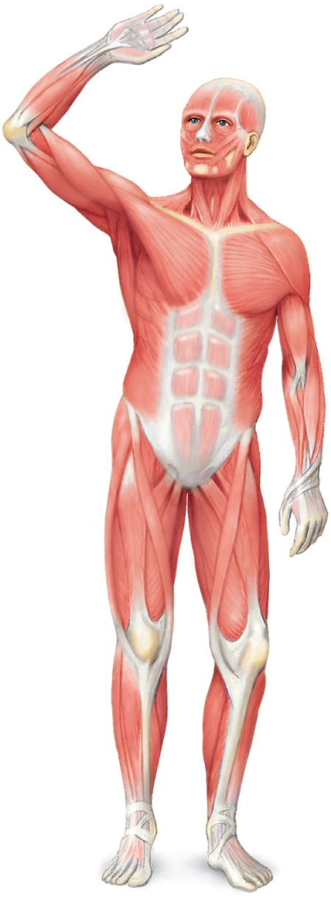
Structure of Skeletal Muscle
Organ of the muscular system
Skeletal muscle tissue
Nervous tissue
Blood
Connective tissue
Fascia
Tendons
Aponeurosis

Slide 7
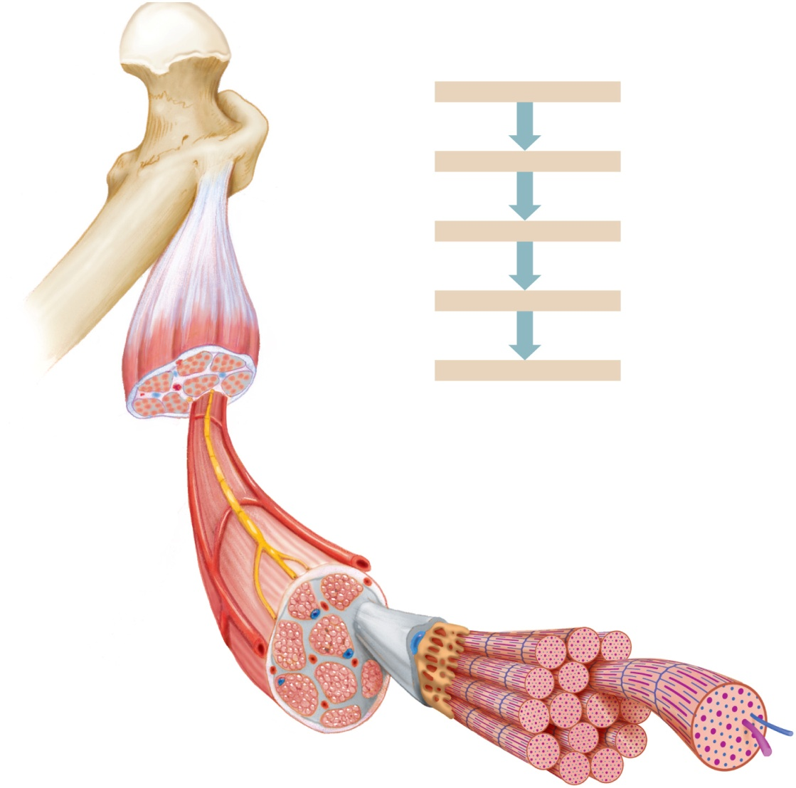
Connective Tissue Coverings
Muscle coverings:
Epimysium
Perimysium
Endomysium
.
Muscle
Bone
Fascicles
Tendon
Muscle fibers (cells)
Fascia
(covering muscle)
Muscle organ
Fascicles
Muscle cells or fibers
Myofibrils
Thick and thin myofilaments
Actin and myosin proteins
Titin is an elastic myofilament
Myofibrils
Epimysium
Thick and thin filaments
Perimysium
Endomysium
Fascicle
Axon of motor
neuron
Blood vessel
Nucleus
Sarcoplasmic
reticulum
Myofibril
Filaments
Muscle fiber
Sarcolemma
5

Slide 8
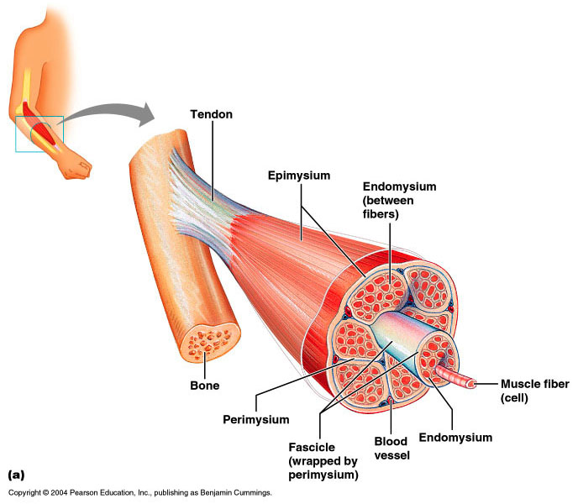
Skeletal Muscle

Slide 9
Skeletal Muscle: Attachments
Most skeletal muscles span joints and are attached to bone in at least two places
When muscles contract the movable bone, the muscle’s insertion moves toward the immovable bone, the muscle’s origin

Slide 10
Myofibrils
Myofibrils are densely packed, rodlike contractile elements
Hundreds to thousands of myofibrils are in a single muscle fiber
They make up most of the muscle volume
The arrangement of myofibrils within a fiber is such that a perfectly aligned repeating series of dark A bands and light I bands is evident

Slide 11
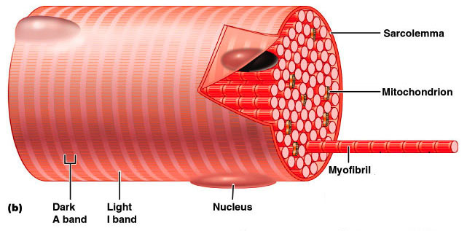
Myofibrils

Slide 12
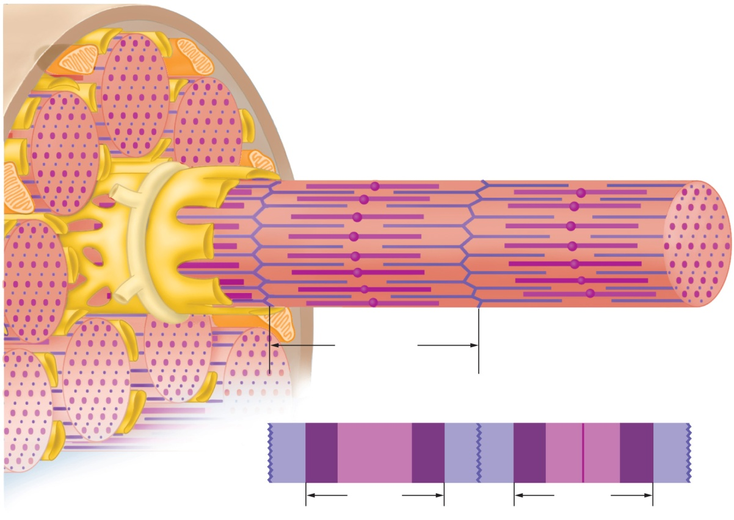
Skeletal Muscle Contraction
Movement within the myofilaments
I band (thin)
A band (thick and thin)
H zone (thick)
Z line (or disc)
M line
.
Skeletal muscle fiber
Sarcoplasmic
reticulum
Thick (myosin)
filaments
Thin (actin)
filaments
Myofibril
Sarcomere
Z line
H zone
Z line
M line
I band
A band
I band
A band
(a)
(b)

Slide 13
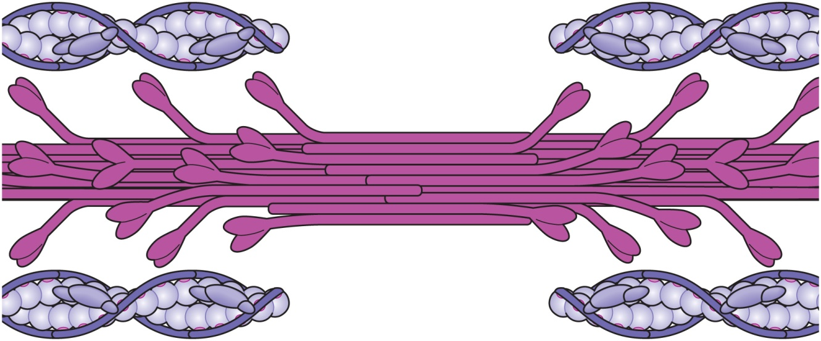
Myofilaments
Thick myofilaments
Composed of myosin protein
Form the cross-bridges
Thin myofilaments
Composed of actin protein
Associated with troponin and tropomyosin proteins
.
Cross-bridges
Thin filament
Troponin
Tropomyosin
Myosin
molecule
Thick
filament
Actin molecule

Slide 14
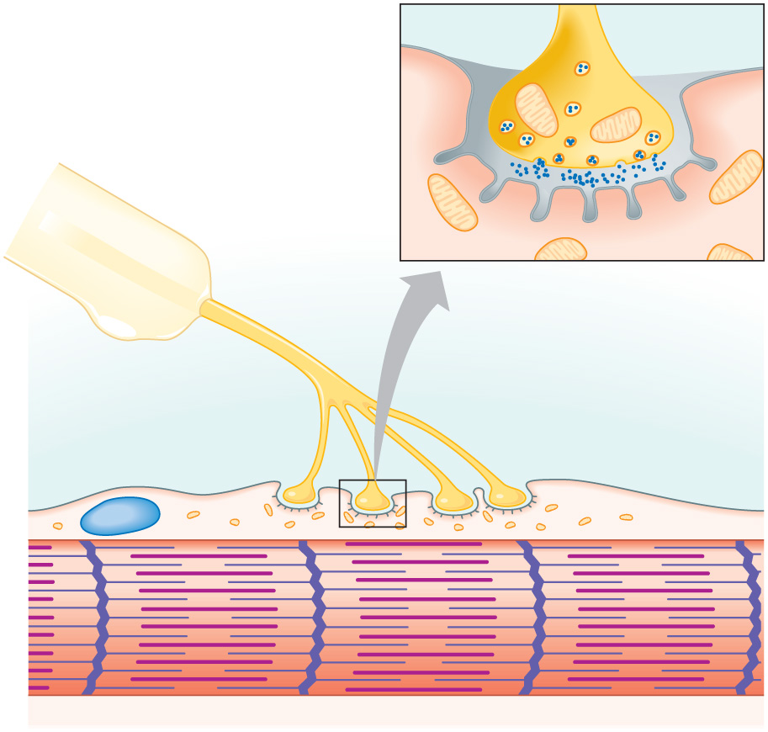
Neuromuscular Junction
Also known as NMJ or myoneural junction
Site where an axon and muscle fiber meet
Parts
Motor neuron
Motor end plate
Synapse
Synaptic cleft
Synaptic vesicles
Neurotransmitters
display.
Synaptic
vesicles
Mitochondria
Motor
neuron axon
Acetylcholine
Synaptic
cleft
Folded
sarcolemma
Axon branches
Motor
end plate
Muscle fiber
nucleus
Myofibril of
muscle fiber
(a)

Slide 15
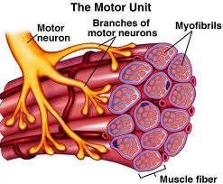
Motor Unit
Single motor neuron
All muscle fibers controlled by motor neuron
As few as four fibers
As many as 1000’s of muscle fibers

Slide 16
Skeletal Muscle Physiology
1) The brain initiates an impulse for the muscles to contract
2) It only takes 2 neurons to tell the skeletal muscle to contract
In brain to cord
Cord to muscle
3) Motor neuron sends an impulse to the muscle cells to contract the motor neuron and the muscle cells that innervate it
4) The neuron action potential continues down the neuron to muscle cells (motor unit) and the action potential continues into muscle cells

Slide 17
5) As the action potential goes down the muscle cell along the sarcolema and the T Tubules
6) When the action potential passes over the T Tubules, it releases calcium to contract the muscle

Slide 18
Ratchet Theory or Sliding Filament Mechanism
Denotes the idea of how the myosin cross-bridge pull on the action filament in a ratchet-like manner.
A ratchet wrench puts tension on a bolt, then lets go of the tension as you swing it back, then exerts the tension again
Similarly, a myosin cross-bridge pulls on the actin filament exerting tension, then it relaxes by letting go, exerts tension once again and then relaxes.

Slide 19
Muscle Tone
Is the constant, slightly contracted state of all muscles, which does not produce active movements
Keeps the muscles firm, healthy, and ready to respond to stimulus
Spinal reflexes account for muscle tone by:
Activating one motor unit and then another
Responding to activation of stretch receptors in muscles and tendons

Slide 20
Isotonic Contractions
In isotonic contractions, the muscle changes in length and moves the load
The two types of isotonic contractions are concentric and eccentric
Concentric contractions – the muscle shortens and does work
Eccentric contractions – the muscle contracts as it lengthens

Slide 21
Isometric Contractions
Tension increases to the muscle’s capacity, but the muscle neither shortens nor lengthens

Slide 22
Muscle Metabolism: Energy for Contraction
ATP is the only source used directly for contractile activity
As soon as available stores of ATP are hydrolyzed (4-6 seconds), they are regenerated by:
The interaction of ADP with creatine phosphate (CP)
Anaerobic glycolysis
Aerobic respiration

Slide 23
Muscle Fatigue
Muscle fatigue – the muscle is in a state of physiological inability to contract
Muscle fatigue occurs when:
ATP production fails to keep pace with ATP use
The deficit of ATP causes contractures
Lactic acid accumulates in the muscle

Slide 24
Recruitment of Motor Units
Recruitment - increase in the number of motor units activated
Whole muscle composed of many motor units
More precise movements are produced with fewer muscle fibers within a motor unit
As intensity of stimulation increases, recruitment of motor units continues until all motor units are activated

Slide 25
Sustained Contractions
Smaller motor units (smaller diameter axons) - recruited first
Larger motor units (larger diameter axons) - recruited later
Produce smooth movements
Muscle tone – continuous state of partial contraction

Slide 26
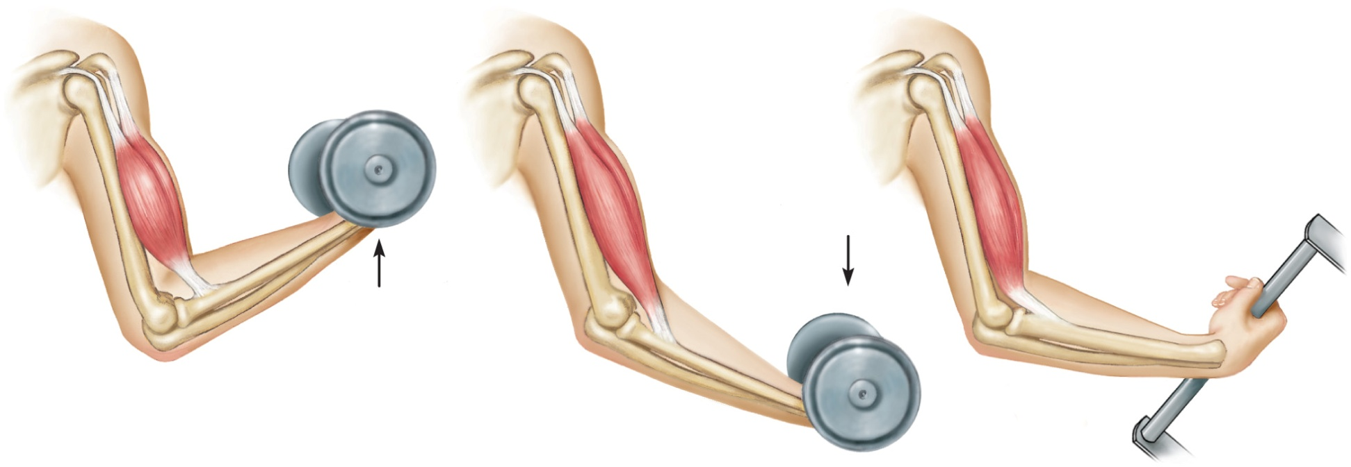
Types of Contractions
Isotonic – muscle contracts and changes length
Concentric – shortening contraction
Eccentric – lengthening contraction
Isometric – muscle contracts but does not change length
(a) Muscle contracts with
force greater than
resistance and
shortens (concentric
contraction)
(b) Muscle contracts
with force less than
resistance and
lengthens (eccentric
contraction)
(c) Muscle contracts but
does not change length
(isometric contraction)
No
movement
Movement
Movement
29

Slide 27
Fast Twitch and Slow Twitch Muscle Fibers
Slow-twitch fibers
Always oxidative
Resistant to fatigue
Red fibers
Most myoglobin
Good blood supply
Fast-twitch fatigue-resistant fibers
Intermediate fibers
Oxidative
Pink to red in color
Resistant to fatigue
Fast-twitch fibers
White fibers
Poorer blood supply
Susceptible to fatigue

Slide 28
Force of Muscle Contraction
The force of contraction is affected by:
The number of muscle fibers contracting – the more motor fibers in a muscle, the stronger the contraction
The relative size of the muscle – the bulkier the muscle, the greater its strength
Degree of muscle stretch – muscles contract strongest when muscle fibers are 80-120% of their normal resting length

Slide 29
Skeletal Muscle – The Big Picture
A skeletal muscle attaches to two bones and crosses the joints between the bones
The big picture is that when the muscles contract, it shortens it’s center
The contraction creates a pulling force on the boney attachments
If the pulling force is strong enough, one or both of the bones that attaches to the muscle will be pulled toward the center of the muscle
Because bones are located within body parts, movements of a bone results in movement of a body part

Slide 30
Interactions of Skeletal Muscles
Skeletal muscles work together or in opposition
Muscles only pull (never push)
As muscles shorten, the insertion generally moves toward the origin
Whatever a muscle (or group of muscles) does, another muscle (or group) “undoes”

Slide 31
Naming Skeletal Muscles
Number of origins – e.g., biceps (two origins) and triceps (three origins)
Location of attachments – named according to point of origin or insertion
Action – e.g., flexor or extensor, as in the names of muscles that flex or extend, respectively

Slide 32
Naming Skeletal Muscles
Location of muscle – bone or body region associated with the muscle
Shape of muscle – e.g., the deltoid muscle (deltoid = triangle)
Relative size – e.g., maximus (largest), minimus (smallest), longus (long)
Direction of fibers – e.g., rectus (fibers run straight), transversus, and oblique (fibers run at angles to an imaginary defined axis)

Slide 33
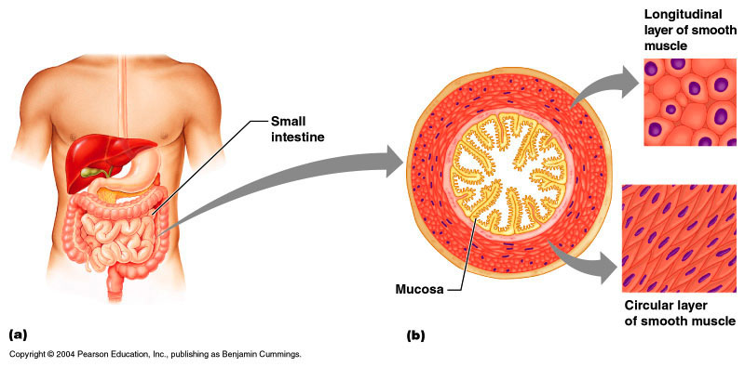
Smooth Muscle
Found in walls of hollow organs (except the heart)
Have essentially the same contractile mechanisms as skeletal muscle

Slide 34
Peristalsis
When the longitudinal layer contracts, the organ dilates and contracts
When the circular layer contracts, the organ elongates
Peristalsis – alternating contractions and relaxations of smooth muscles that mix and squeeze substances through the lumen of hollow organs

Slide 35
Developmental Aspects: Male and Female
There is a biological basis for greater strength in men than in women
Women’s skeletal muscle makes up 36% of their body mass
Men’s skeletal muscle makes up 42% of their body mass

Slide 36
Developmental Aspects: Age Related
With age, connective tissue increases and muscle fibers decrease
Muscles become stringier and less elastic
By age 80, 50% of muscle mass is lost (sarcopenia)
Regular exercise reverses sarcopenia
Aging of the cardiovascular system affects every organ in the body

