Slide 1
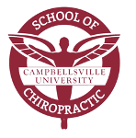
Brain Clinical Review
Dr. Gary Mumaugh

Slide 2
Brain Functions
Sensory Information
Motor System
Behavioral State
Sleep
Motivation

Slide 3
Brain Functions
Moods
Learning and Memory
Language
Personality

Slide 4
Sensory Information
Integration of spinal reflexes
Primary somatic sensory cortex
Termination point of pathways from skin, musculoskeletal system, and viscera
Somatosensory pathways
Touch
Temperature
Pain
Itch

Slide 5
Sensory Information
Body position
Special senses have devoted regions
Visual cortex
Auditory cortex
Olfactory cortex
Gustatory cortex
Neural pathways extend from sensory areas to association areas, which integrate stimuli into perception

Slide 6
Motor System
Three major types
Skeletal muscle movement
Somatic motor division
Neuroendocrine signals
Hypothalamus and adrenal medulla
Visceral responses
Autonomic division

Slide 7
Motor System
Voluntary movement
Primary motor cortex
Motor association areas
Neuroendocrine and visceral responses are coordinated in the hypothalamus and medulla.

Slide 8
Behavioral State
Modulator of sensory and cognitive processes
Neurons collectively known as diffuse modulatory systems
Originate in reticular formation in brain stem
Project axons to large areas of the brain
Reticular activating system controls consciousness

Slide 9
Motivation
Defined as internal signals that shape voluntary behaviors
Some states known as drives
Work with autonomic and endocrine responses
Motivated behaviors stop when a person has reached a certain level of satiety
Pleasure and addictive behaviors: link to dopamine

Slide 10
Moods
Similar to emotions but longer-lasting
Mood disorders
Fourth leading cause of illness worldwide today
Depression
Sleep and appetite disturbances
Alterations of mood and libido
May affect function at school or work or in personal relationships
Antidepressant drugs alter synaptic transmission

Slide 11
Learning and Memory
Learning has two broad types
Associative learning
Non-associative learning
Habituation and sensitization
Associative & Nonassociative Learning

Slide 12
Learning and Memory
Memory has several types
Short-term and long-term
Working memory and consolidation
Reflexive and declarative
Stored in memory traces
Anterograde amnesia is inability to remember new information (Retrograde is past)
Memory loss in the elderly can be caused by dementia and Alzheimer’s disease

Slide 16
Language
Integration of spoken language involves two regions
Damage to Wernicke’s area causes receptive aphasia
Difficulty understanding written or spoken language
Damage to Broca’s area causes expressive aphasia
Inability to produce language (written, manual, spoken)

Slide 17
Personality
Combination of experience and inheritance
Schizophrenia
Both genetic and environmental basis

Slide 19
Brain Stem
Cerebellum
Movement coordination
Equilibrium and balance
Diencephalon
Thalamus: relay station and integration of sensory input
Hypothalamus: control of homeostasis, hunger, thirst, endocrine function
Pituitary
Pineal gland

Slide 20
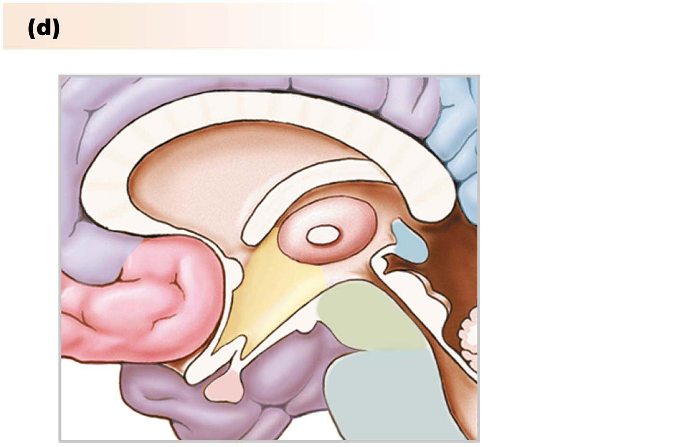
Diencephalon
Thalamus
Pineal gland
Hypothalamus
Pituitary gland
Notes:
Figure 9.8d Anatomy Summary

Slide 21
The Medulla Oblongata
Location –superior continuation of the cord
Major clinical note: The medulla is the region of the brain that is least affected by general anesthesia
Functions
Relay station and conduction pathway between the spinal cord and higher levels of the brain for ascending and descending fiber tracts.

Slide 22
Visceral Reflex Centers of Medulla
Cardiovascular Reflex Center
Regulates blood pressure
Respiratory Reflex Center
Regulates O2, CO2, pH levels
Associated centers that act to modulate breathing patterns
Coughing reflex center (forced exhalation)
Sneezing reflex center (forced exhalation)
Swallowing (deglutition) reflex center
Vomiting reflex center (Note: breathing stops in swallowing and vomiting)

Slide 23
Vestibular reflex center (balance reflexes)
Reflexes maintain optimal orientation of the head and body and tracking of the eyes (when spinning or rotating)
Sensory inputs
Visual information of the eyes
Special information from proprioceptors and the vestibular apparatus

Slide 24
Vestibular reflex center
(balance reflexes)
- Principle Influences (outputs)
Body posture (via extrapyramidal tracts)
Movements of the eyes (via vestibuloocular tracts)
Vomiting reflex center
Higher brain centers (including cerebellum and cerebral cortex)

Slide 25
Clinical Considerations of Medulla Oblongata
Vertigo
Loss of optimal orientation
Sensation of “spinning”
Motion sickness
Nystagmus
Rhythmic to-and–fro movements of the eyes
The eyes drift in the direction of spinning with rapid return in the opposite direction.

Slide 26
The Midbrain
A relay center for the extrapyramidal tracts
Visceral Reflex Center
Salivation reflex center
Tearing reflex center
Oculomotor reflex center
Regulates pupil size
Controls reflex movement and accommodation of the eyeballs for focusing near and far

Slide 27
The Thalamus
The waking center
In the cerebral hemispheres, on each side of the 3rd ventricles
Functions
All sensory information (except olfaction) is processed through the thalamus
The thalamus acts as a “sensory filter” that screens relevant information, then relays the information to higher brain centers
The amount of information relayed to the cerebral cortex affects one’s level of consciousness (alertness)
Called Reticular Activating Center or Waking Center

Slide 28
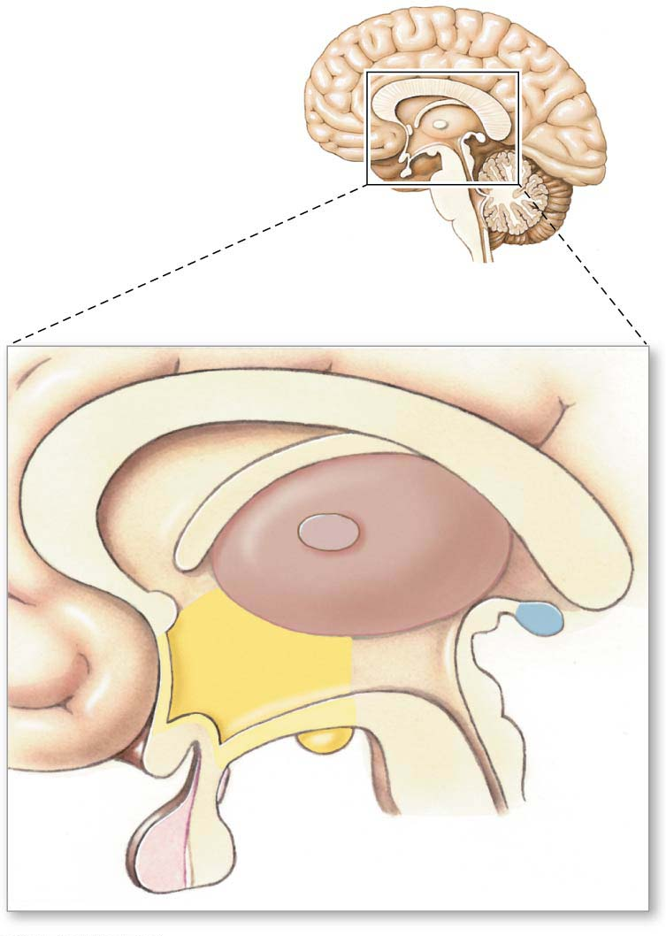
Corpus
ca
llo
sum
Thalamus
Hypothalamus
Pineal
gland
Anterior
pituitary
Posterior pituitary
Notes:
Figure 9.9 The deiencephalon

Slide 29
Levels of Alertness
The person’s emotional state affects his level of alertness (via limbic system)
Clinical considerations
Action of CNS stimulants
Exerts neural activity
Epinephrine, caffeine, amphetamines
Actions of hallucinogens
Exerts extreme stimulation
LSD, psilocybin (mushrooms)

Slide 30
Actions of CNS depressants
Inhibits neural activity
Alcohol, sedatives
Lesions in the thalamus
Injury stops transmission of signals from thalamus to the cerebral cortex >>>>>>>>> COMA

Slide 31
Cerebrum
Is the Site of Higher Brain Functions
Corpus callosum connects the two hemispheres
Gray matter
Cerebral cortex
Basal ganglia: control of movement
Limbic system: link between cognitive functions and emotions
Amygdala: emotion and memory
Hippocampus: learning and memory

Slide 32
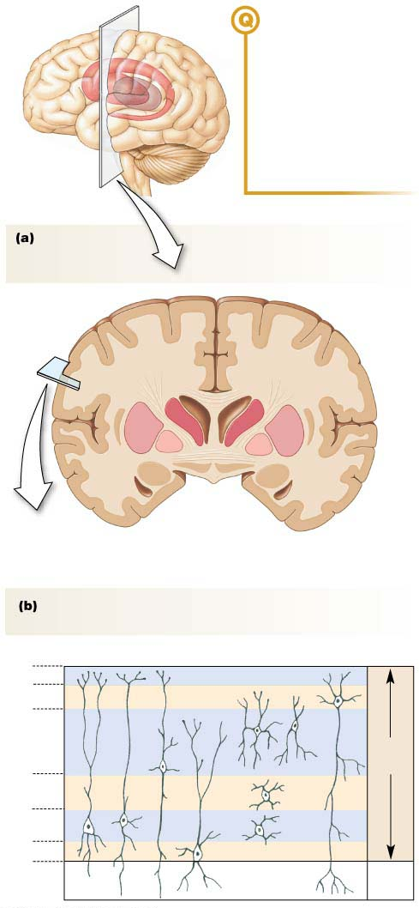
FIGURE QUESTION
The section through this
brain is a section through
the _________ plane.
(a) coronal
(b) lateral
(c) frontal
(d) transverse
(e) sagittal
Section through
the brain showing
the basal ganglia
Corpus
callosum
Basal
ganglia
Lateral
ventricle
Tracts of
white matter
Tip of lateral
ventricle
Gray matter of
cerebral cortex
Cell bodies in the cerebral cortex form distinct layers
and columns.
Outer surface of the cerebral cortex
1
2
Layers
3
Gray
matter
4
5
6
White
matter
Notes:
Figure 9.10 Gray matter of the cerebrum

Slide 33
Cerebral Cortex
Functionally divided into three specializations
Sensory areas
Sensory input translated into perception (awareness)
Motor areas
Direct skeletal muscle movement
Association areas
Integrate information from sensory and motor areas
Can direct voluntary behaviors
Cerebral lateralization

Slide 35
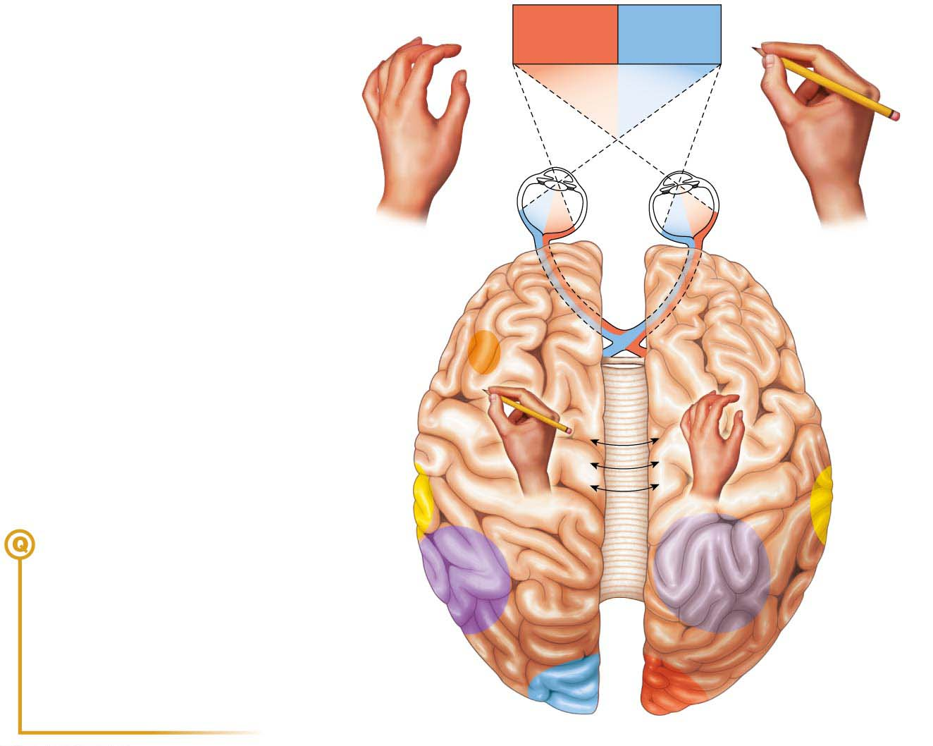
LEFT HAND
RIGHT HAND
Prefrontal
cortex
Prefrontal
cortex
Speech
center
C
O
R
P
Writing
U
Analysis
by touch
S
C
Auditory
cortex
(right ear)
A
Auditory
cortex
(left ear)
L
L
FIGURE QUESTIONS
O
1. What would a person see if a stroke destroyed all function in the right visual cortex?
S
General
interpretive
center
(language and
mathematical
calculation)
U
Spatial
visualization
and analysis
M
2. What is the function of the corpus callosum?
3. Many famous artists, including Leonardo da Vinci and Michelangelo, were left-handed. How is this related to cerebral lateralization?
Visual cortex
(right visual field)
Visual cortex
(left visual field)
LEFT
HEMISPHERE
RIGHT
HEMISPHERE
Notes:
Figure 9.14 Cerebral lateralization

Slide 36
The Cerebral Cortex
Consists of right and left hemispheres, joined together by 300 million myelinated commissural fibers (Corpus Callosum)
Cerebral hemispheres show hemisphere specialization
The dominant hemisphere (left side of 90% of population) controls:
Voluntary movement using the dominant hand (right) and side of the body (primary motor area)

Slide 37
The Cerebral Cortex
Sensory discrimination on the dominant (right) side of the body (primary sensory area)
Stereogenesis using the dominant (right)
Mental construct through touch
Recognizing an object by feeling
Understanding of written and oral language
Wernicke’s Area is located only in the dominant hemisphere

Slide 38
The Cerebral Cortex
Performance of Speech
Aphasia – inability to speak because of damage to Brocca’s Speech Center
Only in the dominant hemisphere
Mathematical computations and analytic logic – only in dominant
Learned reflexes and behaviors
Driving a car, doing a task, performing a procedure
Only in dominant hemisphere

Slide 39
The subordinate hemisphere (right side of 90% of population) controls:
Voluntary movement using the weaker hand and weaker side of the body
Sensory discrimination on the weaker (left) side of the body
Stereogenesis using the weaker (left) hand
Spatial relations and tasks
Drawing figures, etc.
Musical abilities
Sense of body posture and balance
Example – dancer, surgeon, dentist
“Artistic” or intuitive thinking

Slide 40
Other Cerebral Functions
Not localized
Involves activity throughout cerebrum
Consciousness
Awareness of the environment (wakefulness)
Sensations (perceptions)
Self awareness or self cognitions
“aware that you are aware”
“cognition”
Social behaviors
Moral and ethical values

Slide 41
Pathologies and Disorders of the Cerebral Cortex
Viral encephalitis
Clinical manifestations depend on which area of the brain has been damaged
Cerebral palsy
Usually damage to a motor area due to cerebral ischemia

Slide 42
Dyslexia
Inability to properly read or write words
Mistakes “b” for “d” when reading
Writes “was when wanted to write “saw”
Occurs in up to 15% of schoolchildren
6 times more common in males
Hypothesis is a lack of cerebral dominance for understanding language
Cretinism
Retarded brain and body development
Caused by a deficiency of thyroxin from birth

Slide 43
Reading with Dyslexia

Slide 44
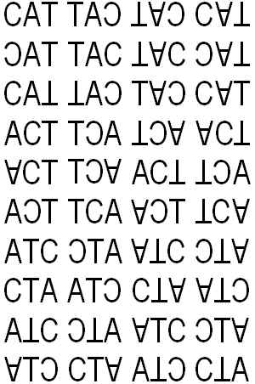
The Medulla Oblongata

Slide 46
CVA Cerebral Vascular Accident
CVA – cerebral vascular accident
Etiology
Cerebral thrombus
Cerebral hemorrhage
Decreased cerebral blood flow >>>>> cerebral ischemia (lack of O2) >>>>>
cerebral infarction(death of brain cells)

Slide 47
CVA
Clinical symptoms may include aphasia, limb paralysis or death
Neuroplasticity of the cerebral cortex
Capacity of the brain to learn new tasks and compensate for the loss of damaged brain areas
Two pairs of arteries carrying O2 to the brain
Right and left internal carotid arteries
Right and left vertebral arteries

Slide 48
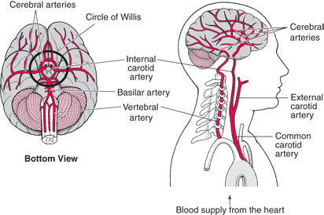

Slide 50
The Cerebellum (“little brain”)
Located on the dorsal surface of the brainstem
Functions
Unconsciously maintains body posture and balance
Unconsciously coordinates voluntary motor activity
Unconsciously modulates “set point” of muscle spindles to maintain some degree of muscle tonus (partial contraction)

Slide 51
Inputs and Outputs
The cerebellum receives kinesthetic and proprioceptive information.
It evaluates it and subconsciously activates skeletal muscles to maintain posture and balance and coordinate skeletal muscular movements.
Clinical symptoms associated with cerebellar lesions (injuries)
Cerebellar ataxia – loss of coordination
Dysarthria – hesitating and slurred speech
Hypotonia – (muscle flaccidity) decreased muscle resistance to stretch “limp”
Decomposition of voluntary movements

Slide 52
Basal Nuclei (Subcorticol Nuclei)
Located very deep within the white matter of each cerebral hemisphere
Exerts primarily an inhibitory influence on the somatic motor neurons (via extrapyramidal tracts)
Functions
Generation of mannerisms
Stretching, tics and twitches

Slide 53
Clinical symptoms associated with basal ganglia lesion (injuries)
Resting muscle tremors
Hypertonia (muscle rigidity)
Increased muscle resistance to stretch
Delay in initiating movement
Example – Parkinson’s Disease (“paralysis agitans”)
1st discovered in 1817 by Dr. James Parkinson
Associated with decreased dopamine in the basal ganglia
Treatment: L-Dopa >>>> increases dopamine level in brain

Slide 54
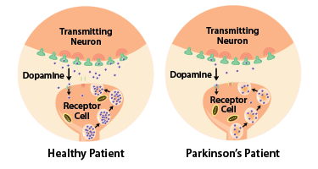
Progress and Promise in Parkinson's Disease

Slide 56
The Limbic System
Consists of a complex network of neurons in many associated areas of the brain including:
Olfactory bulbs
Parts of the cerebral cortex
Parts of the thalamus
Parts of the hypothalamus
Amygdeloid nucleus or amygdala

Slide 57
Functions
Generations of emotions
Happiness, joy, and euphoria
Anger and rage
Anxiety, fear, and terror
Sadness and depression
Emotional state can affect the general level of alertness (via thalamus RAS)

Slide 58
Anxiety, Fear, Excitement, Anger >>>>>>>> increased level of alertness
Depression, sadness >>>>>>>>>>> decreased level of alertness (sedation)
Motivation (Motivation causes passion)
Short term memory and learning
Motivation and passion are needed for learning
Sense of smell
Odors (like perfumes and aftershave) affect
Sensitivity to pain (pain is an emotion)
Sexual behavior

Slide 59
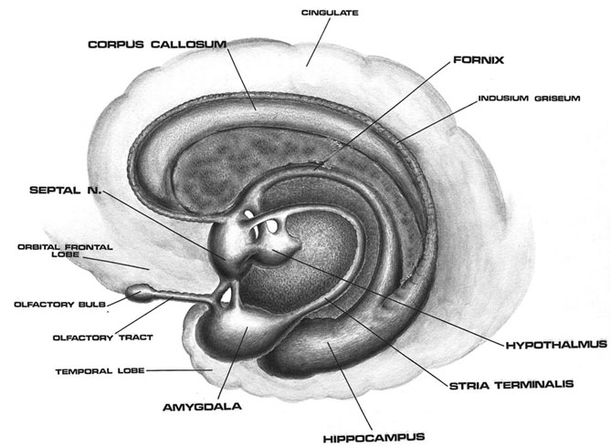
The Medulla Oblongata
Bbbbb
Bbbbbb
Bbbbbb

Slide 60
Limbic System - Clinical Considerations
Rabies – viral infection that damages the limbic system
Schizophrenia
Antisocial
Increased dopamine
Familial (genetic)

Slide 61
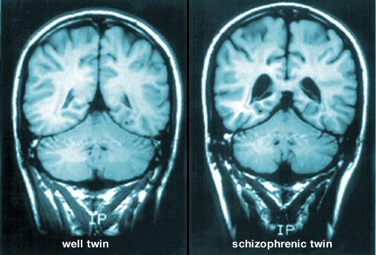
The Medulla Oblongata

Slide 62
Bipolar Mania and Depression
Mania (“Hyper”; Impulsive)
A form of aggression
Increased levels of norepinephrine and serotonin
Rx – lithium
Depression (“sad”; reclusive)
Increased catecholamine levels in the brain
Decreased norepinephrine and increased serotonin
Rx – use anti-depressants and ECS

Slide 63
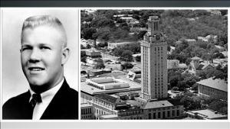
Case Study in Amygdala-Aggression:
Charles Whitman
Charles Whitman Case

Slide 64
The Hypothalamus
Located just below the thalamus and the third ventricle
Linked to the pituitary gland by
Nerve fiber tracts
Profuse network of capillaries – (hypothalamic-pituitary portal system)

Slide 65
Functions
Visceral reflex centers
Thermoregulatory reflex center
Appetite / satiety reflex center
Osmoregulatory reflex center
Modulates activities of lower visceral reflex centers
Cardiovascular reflex center
(blood pressure) - in medulla
Swelling and vomiting reflex center - in medulla
Micturation reflex center - in spinal cord
Defecation reflex center - in spinal cord

Slide 66
Adjusts the activity of the various visceral organs to match the physical activity and energy requirements of the person
Via descending autonomic fiber tract and the autonomic motor neurons HOMEOSTASIS
Secretes two hormones
ADH – vasopressin
Oxytocin

Slide 67
Secretes releasing hormones that affect the anterior lobe of the pituitary
These releasing hormones are carried by the anterior pituitary gland via the hypothalamic-pituitary portal veins
Different releasing hormones stimulate the release of the anterior pituitary hormones.
CRH – Corticotropin Releasing Hormone
TRH – Thyrotropin Releasing Hormone
GnRH – Gonadotropin Releasing Hormone
Growth Hormone Releasing Hormone
Growth Hormone Inhibitory Hormone
Prolactin Releasing Hormone
Prolactin Inhibitory Hormone

Slide 68
Cerebral
Cortex
Cerebellum
Corticocerebellar Tract
Vestibular
Apparatus
Vestibular Cerebellar Tract
Midbrain
Peripheral
Receptors
Extra Pyramidal Tract
Somatic Motor Neurons
Skeletal System

Slide 69
CNS Tumors
Pituitary gland
Pituitary adenoma – 2 types
“Secreting type” (less common)- secretes excess hormones
“Null cell”- goes undetected until there is damage
Symptoms: “tunnel vision,” cranial nerve compression, hypopituitarism (if blood supply compressed)
Treatment - surgery or radiation

Slide 72
CNS Tumors

Slide 73
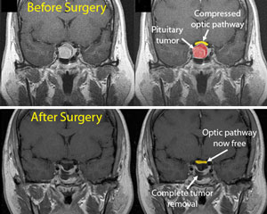
CNS Tumors
Brain Tumors

Slide 74
Brain Depository - Young Frankenstein

