Slide 1
Neuron Anatomy & Cell Function
Dr. Gary Mumaugh

Slide 2
Major Parts of Neurons
Dendrites
Cell Body or Soma
Axons
Axon Terminals

Slide 4
Dendrites
Short (usually, about 100 microns in length) protoplasmic extensions that arise from body
Primarily involved in receiving neural signals from other neurons
Extensions of the cell body of the neuron that act as neurotransmitter receptors at a synapse
Dendritic cell membranes contain different types of Channels and receptors:
Ligand-gated ion channels
Quick response
Neurotransmitter binds to allosteric site, opening up channel

Slide 5
G-Protein Coupled Receptors (GPCR)
Slower response
Neurotransmitter binds to receptor
These receptors work by allowing positive or negative ions to enter the cell:
Positive Ions
Excitatory Postsynaptic Potential (EPSP)
EPSPs cause depolarization
Negative on outside and positive on inside
Negative Ions
Inhibitory Postsynaptic Potential (IPSP)
IPSPs cause hyperpolarization
Positive on inside and negative on inside

Slide 7
Cell Body
Also called a soma (= “body”; plural = somata)
Contains nucleus, nucleic acids, and the usual organelles
Typically, neurons are very active metabolically in order to support neural signaling and the synthetic requirements that are necessary to maintain the intricate protoplasmic processes that arise from the body

Slide 8
Cell Body / Soma
The functions of the cell body include:
Receiving graded potentials through receptors on its membrane (same as dendrites)
Synthesizing the proteins necessary for cell function: DNA from the nucleus is transcribed into mRNA mRNA travels to the rough endoplasmic reticulum
Proteins travel to the Golgi apparatus where they are packaged into vesicles

Slide 9
Types of proteins synthesized in the cell body include:
Neurotransmitters
Enzymes
Membrane proteins
Neurons constantly receive hundreds of both IPSPs and ESPs through dendrites and cell body receptors.
These are known as graded potentials.
In order for a neuron to be able to process action potentials, the sum of these voltages must reach a threshold of -55mV

Slide 11
Axons
Long protoplasmic extension that arises from body
For some neurons, the axons are very short (<100 μm)
For others, axons can be very long (> 1 meter!)
Involved in the transmission or sending of neural signals away from the cell body and toward other neurons or effector cells
Other Nerves
Muscles
Glands

Slide 12
The main function of the axon is to conduct an Action Potential.
EPSPs cause the membrane potential to reach the threshold of -55mV
Voltage-gated Sodium Channels open, allowing Na+ ions into the cell and further depolarizing it
This depolarization wave is transmitted down the axon to the axon terminal where it causes release of neurotransmitters
When the voltage inside the cell reaches +30mV, Voltage-gated Potassium channels open, allowing K+ to leave the cell and repolarizing it
This repolarization wave also travels down the axon

Slide 13
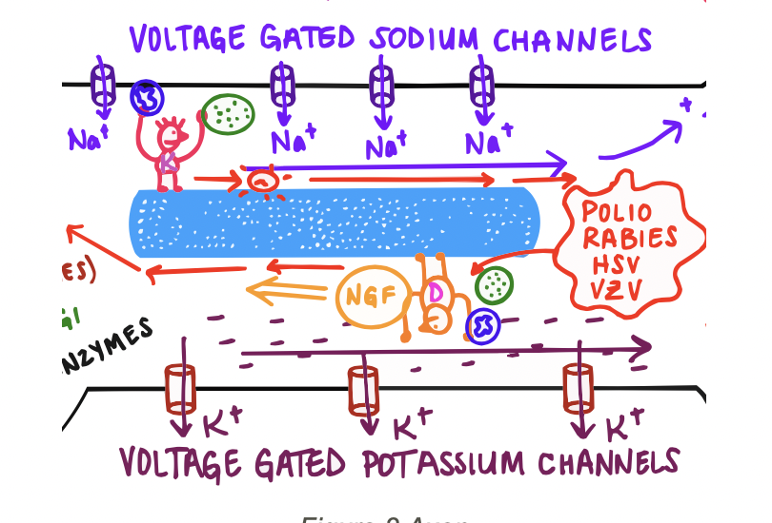
The other major function of the axon is to perform Axonal Transport
The movement of molecules between the cell body and the axon terminal via microtubules

Slide 14
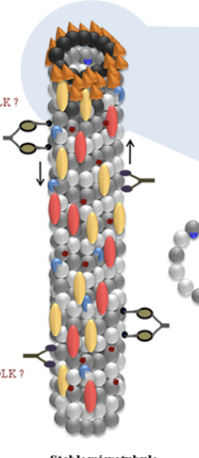
Anterograde Axonal Transport
From cell body to axon terminal
Transports:
Proteins in vesicles
Neurotransmitters, enzymes, membrane proteins
Mitochondria
Dormant pathogens that have been activated
(Example shingles)

Slide 15
Retrograde Axonal Transport
From axon terminal to cell body
Transports:
Vesicles + mitochondria to be degraded/recycled
Nerve Growth Factors (produced at damaged parts
of a neuron to stimulate repair/growth)
Pathogens
Polio, Rabies, Herpes simplex, Herpes zooster

Slide 16
Axon Terminal
Specialized contacts among neurons and between neurons and effector cells
Synapses may be “electrical” (the small minority in the mature CNS)
Synapses may be “chemical” (the vast majority in the mature CNS)
Usually found at the end of axons, with an axon terminal contacting a dendrite of another neuron
Axon terminals may contact cell bodies or even other axon terminals

Slide 17
Functions of Synapse
Neurotransmitter release
When a depolarization wave from an action potential reaches the axon terminal, it activates Voltage-gated Calcium channels
Ca⁺⁺ enters the cell and allows the fusion of neurotransmitter-containing vesicles with the cell membrane
Snare proteins in vesicles and snare proteins on the cell membrane connect and pull toward each other
Neurotransmitters are released into the synapse

Slide 19
Function of Synapse
Neurotransmitter reuptake
After the neurotransmitters pass on the action potential to the next neuron, they need to be removed from the synapse
This can be done through either:
Degradation - Enzyme on the cell membrane/synapse breaks neurotransmitters down
Reuptake - Reuptake protein on the cell membrane picks up neurotransmitters and brings them back into the cell to be recycled

Slide 20
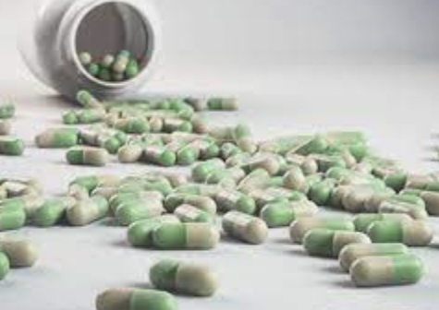
Function of Synapse
Neurotransmitter reuptake
Some drugs (SSRIs - Selective Serotonin Reuptake Inhibiter) block these reuptake proteins resulting in more neurotransmitters available to stimulate post-synaptic neurons

Slide 22
SSRI Reuptake

