Slide 1
Occipital Lobe Anatomy and Function
Dr. Gary Mumaugh
Campbellsville University

Slide 2
Cerebral Cortex – Occipital Lobe Anatomy & Function

Slide 3
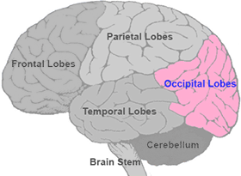
Boundaries of Occipital Lobe
Parietal-Occipital Sulcus
Separates the occipital lobe from the parietal lobe.
Pre-Occipital Notch
Trace an imaginary line between the Pre-occipital notch and the lateral sulcus it’s possible to separate the occipital lobe from the temporal lobe

Slide 4
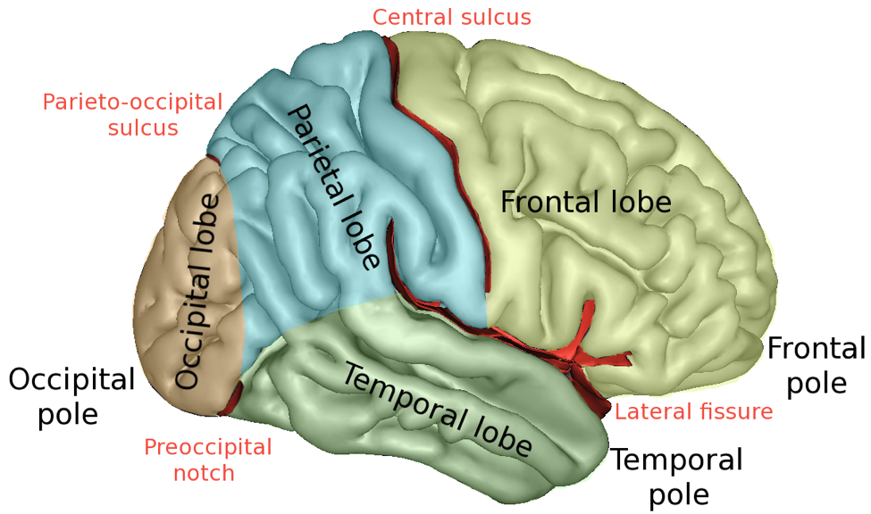

Slide 5
Divisions of Occipital Lobe
Primary Visual Cortex
Involved in conscious awareness of visual stimuli
Visual Association Cortex
Involved in analyzing, recognizing, memorizing and understanding a visual stimulus.

Slide 6
Primary Visual Cortex
Conscious awareness of a visual stimuli
The retina sees an image (basketball example).
The retina does not know what the image is.
It sends the image through the optic nerve into a nucleus in the medulla.
It eventually moves that image forward to primary visual cortex to give the brain a conscious awareness that there is an image.
The primary visual cortex does not know what the image is. It only knows that there is an image.
It sends that information forward in the occipital lobe into the visual association cortex to get some meaning and understanding of the image.

Slide 7
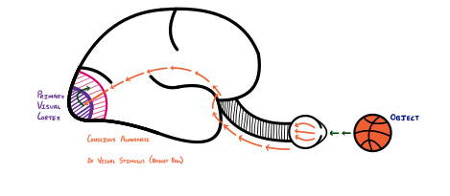
Visual cortex pathway
The retina sees an image (basketball) >>>
optic nerve >>> optic tracts >>> lateral geniculate nucleus >>> optic radiations >>> primary visual cortex is aware that an object is there.

Slide 8
Visual Association Cortex
Involved in analyzing, recognizing, memorizing and understanding a visual stimulus.
The Visual Association Cortex receives the image from the Primary Visual cortex and elaborates its characteristics:
Shape
Color
Size
Movement
Then, compares it to past memories → allows us to recognize the object
We can recognize that the object is a basketball

Slide 10
Summary of Occipital Lobe
The occipital lobe is located in the most posterior portion of the cerebral cortex, between the Parieto-occipital sulcus and pre-occipital notch
It contains:
Primary Visual cortex
Responsible for conscious awareness of visual stimuli
End point of the visual pathway
Visual Association cortex
Responsible for understanding and recognizing a visual stimulus
Compares the stimulus to past memories
If damaged → Visual Agnosia

