Slide 1
Parietal Lobe Anatomy and Function
Dr. Gary Mumaugh
Campbellsville University

Slide 2
Cerebral Cortex – Parietal Lobe Anatomy & Function

Slide 3
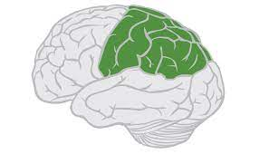
Boundaries of Parietal Lobe
Anteriorly
Separated from frontal lobe by central sulcus
Inferiorly
Separated from temporal lobe by lateral sulcus
Posteriorly
Separated from occipital lobe by parieto-occipital sulcus

Slide 4
Functional Areas of Parietal Lobe
Primary Somatosensory Cortex
Conscious awareness of somatic sensation (touch, pain, temperature, vibrations, pressure, proprioception)
Somatosensory Association Cortex
Analyzing and recognition of somatic sensations
Memory storage of somatic sensations
It is providing meaning and understanding to what we feel

Slide 5
Posterior Association Area
Overlaps parts of occipital and temporal lobes
Integration of somatic, visual and auditory sensations
Also called the parietal-occipital-temporal cortex
From the parietal lobe it is getting somatic sensations
From the occipital lobe it is getting visual sensations
From the temporal lobe it is getting auditory sensations
All these sensations come together in one area and is giving information on spatial coordination

Slide 6
Primary Somatosensory Cortex It is involved with conscious awareness of somatic sensations
Receives sensory information through:
Dorsal Column Medial Lemniscus Pathway - Information on:
Fine Touch and Discriminative Touch
Proprioception
Vibration
Fibers decussate at the medulla and arrive at the contralateral side of the cortex
Practical application of the DCML
The sensations from the left side of the body will ascend to the right cerebral cortex
The sensations from the right side of the body will ascend to the left cerebral cortex

Slide 7
Pathway – All the information received about fine and discriminative touch, proprioception and vibrations travels through the
dorsal root ganglia >>>
to the dorsal gray horn of the cord >>>
it ascends through the DCML tract and goes to the medulla >>>
in the medulla, it crosses over to the opposite side and continues on to the opposite cerebral cortex

Slide 8
Primary Somatosensory Cortex It is involved with conscious awareness of somatic sensations
Spinothalamic Tract Pathways - Information on:
Pain
Temperature
Crude touch
Pressure
Fibers decussate at the spinal cord and arrive at the contralateral side of the cortex
Practical application of the STT
Picks up pain, temperature and touch from the left side of the body and it will go to the right cerebral cortex.
Picks up pain, temperature and touch from the right side of the body and it will go to the left cerebral cortex.

Slide 9
Pathway – All the information received about pain, temperature, touch and pressure travels through the
dorsal root ganglia >>>
to the dorsal gray horn of the cord >>>
it then crosses in the spinal cord to the opposite side before ascending through the STT into the medulla >>>
the medulla takes it up to the opposite cerebral cortex on the same side (opposite of the side where the sensation was)

Slide 10
Primary Somatosensory Cortex
Contributes to 40% of motor function through:
Corticobulbar tracts - From the cortex to the pons
Corticospinal tracts - From the cortex to the spinal cord
Why is this important?
The sensory information can also be processed through the executive reasoning of the frontal lobe and help with motor movement based upon all of that information

Slide 12
Somatotopy Of Parietal Lobe
In the somatosensory Homunculus:
Medial cortex corresponds to lower extremities
Lateral cortex corresponds to upper extremities and face
The bigger a structure, the more sensitivity that area has

Slide 13
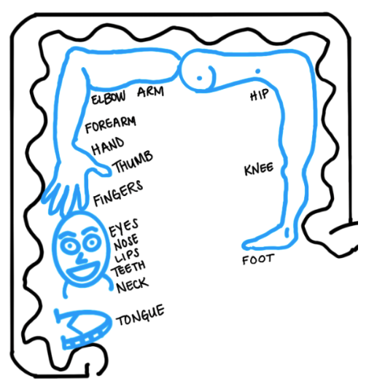
Sensory Homunculus Sensations from lower leg goes to medial part of the primary somatosensory cortex Sensations from upper extremity to lateral part of the primary somatosensory cortex

Slide 14
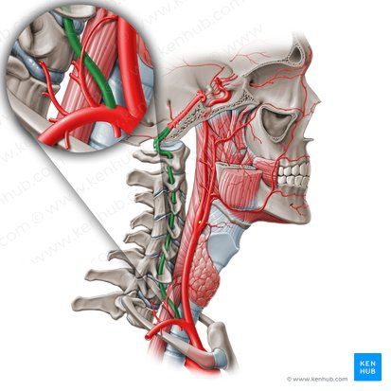
The Internal Carotid Artery

Slide 15
The Internal Carotid Artery
Branches off into an Anterior Cerebral Artery
Goes to lower extremities because it is the medial part of the primary somatosensory cortex.
A stroke of the ACA will lose sensations of the lower extremity on the opposite side of the body.
Also branches of into a middle cerebral artery
Goes to the upper extremities, head and neck because it is the lateral part of the primary somatosensory cortex
A stroke of the MCA will lose sensations of the upper extremity, head and neck on the opposite side of the body.

Slide 16
Clinical Correlation- Stroke
The symptoms of a stroke differ depending on the affected area in the brain:
A lesion of the Anterior Cerebral Artery (A.C.A)
Reduces blood flow to the medial cortex
Results in weakness and loss of sensation of the contralateral lower extremities
Also results in a paralysis of the contralateral lower extremity from blood loss to the primary motor cortex of the frontal lobe

Slide 17
Clinical Correlation- Stroke
The symptoms of a stroke differ depending on the affected area in the brain:
A lesion of the Middle Cerebral Artery (M.C.A.)
Reduces blood flow to the lateral cortex
Results in weakness and loss of sensation of the contralateral upper extremities and face
Also results in a paralysis of the contralateral upper extremity, head and neck from blood loss to the primary motor cortex of the frontal lobe

Slide 18
Somatosensory Association Cortex
Receives somatosensory information from primary association cortex
Analyzes this information to determine
Size of an object
Texture
Weight of an object
Position in 3D space
Compares this information to previous experiences to determine what you are touching (pattern recognition)
Stores the new information in memory

Slide 20
Lesions of Somatosensory Association Cortex
Astereognosis
Inability to identify an object only by touch
Agraphesthesia
Inability to recognize letters or numbers drawn on the skin
Asomatognosia
Inability to identify body part position
Abarognosis - Inability to recognize weight differences

Slide 21
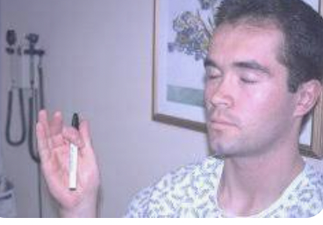
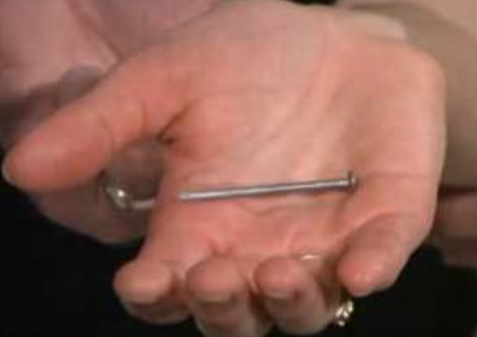
Astereognosis Inability to identify an object only by touch

Slide 22
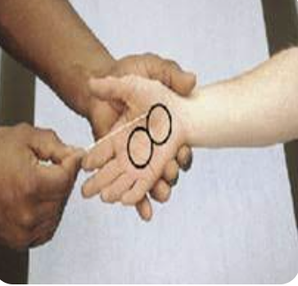
Agraphesthesia Inability to recognize letters or numbers drawn on the skin

Slide 23
Asomatognosia
Asomatognosia is a neurological disorder characterized as loss of recognition or awareness of part of the body. The failure to acknowledge, for example, a limb, may be expressed verbally or as a pattern of neglect.

Slide 24
Abarognosis Inability to recognize weight differences

Slide 25
Posterior Association Area
Receives somatosensory information from primary association cortex
This is a multimodal association area (Integrates stimuli from various areas of your brain)
Receives information from somatosensory, auditory and visual association areas
Puts the information together to:
Make sense of the situations around us
Develop spatial coordination
Communicates with the Pre-frontal cortex and the Motor cortex to determine a plan that also involves motor movement

